Slide 1



Welcome to the Innovative Sustainable Economy Mission
2nd Innovation Camp
BARCELONA 28-29 May 2024

Slide 2
Isabelle Nobio
Joint Secretariat Interreg EuroMED Programme
Alessandro Daraio
Emilia Romagna Region, LP
Dialogue4Innovation
Tatiana Fernàndez,
Government of Catalonia
Notes:
9:30 a 9:55

Slide 3
2nd Innovation Camp
Barcelona
28 May 2024
Notes:
Welcome to the Interreg Euro-MED applicant seminar for the 4th Call for proposals.
The seminar will be recorded and published on our website, together with the PPT presentation, so that you can come back to them whenever needed.
Since we have a lot of participants, we choose the Q&A option for this seminar. Ask your questions and we willhave 2 dedicated slots to answer.
Please mute your microphones.

Slide 4
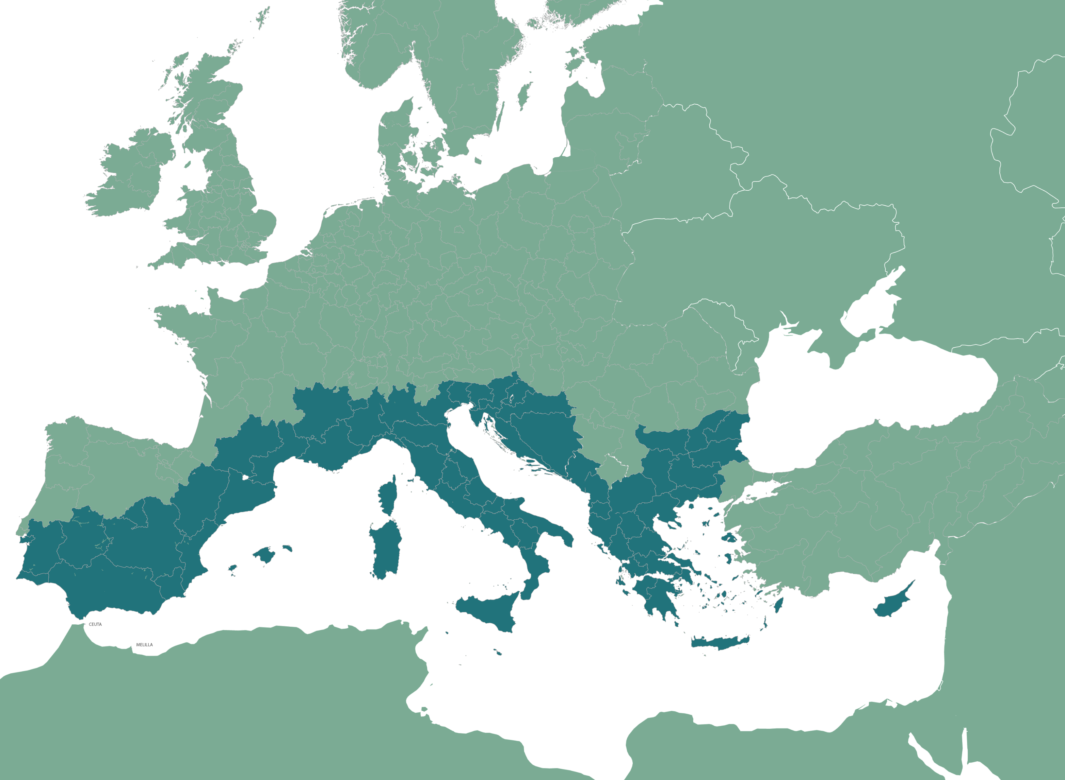










The Interreg Euro-MED Programme
294M€
Notes:
The Interreg Euro-MED Programme is a transnational Programme that brings together partners from 69 regions from 14 participating countries of the Northern shore of the Mediterranean. The total budget is about 294M€ for the 2021/2027 period. Participating countries are Member states, candidates and potential candidates to the European Union.
The Programme’s content and modalities are decided by the countries participating in the Interreg Euro-MED Programme and approved by the European Commission. It has been approved on the 31st of May 2022. Our ambition is to support the transition towards a climate-neutral and resilient society, in line with the European Green Deal, the Sustainable Development Goals of the United Nation, and the Territorial Agenda 2030 and thank to the cooperation and coordination between stakeholders.
Collaborating with the other territories of the Mediterranean is crucial to fulfil our ambition and the participation of associated partners from the Southern and Eastern shores of the sea is also needed.

Slide 5




Interreg Euro-MED’s missions: a comprehensive approach
Strengthening an innovative sustainable economy
Protecting, restoring and valorising the natural environment and heritage
Promoting
green living areas
Enhancing
sustainable tourism
Notes:
Mission Strengthening an innovative sustainable economy
Mission Protecting and valorising the natural environment and heritage
Mission Promoting green living area
Mission Enhancing sustainable tourism
Each mission operates as a portfolio of actions addressing the same thematic issue and enhance the full potential of their results.
The missions push the results of single projects beyond their initial ambitions to address issues of greater importance.

Slide 6




Missions, priorities and specific objectives
Strengthening an innovative sustainable economy
Protecting, restoring and valorising the natural environment and heritage
Promoting green
living areas
Enhancing
sustainable tourism
Smarter Mediterranean
1.1
Consolidating a competitive innovation ecosystem
2.4
Promoting climate change adaptation and risks prevention
2.4
Promoting climate change adaptation and risks prevention
1.1
Consolidating a competitive innovation ecosystem
2.6
2.7
2.6
Supporting circular economy
Enhancing Nature & biodiversity
Supporting circular economy
Greener Mediterranean
Promoting climate change adaptation and risks prevention
2.4
2.7
Enhancing Nature & biodiversity
Better Mediterranen Governance
6.6
A better cooperation governance
Notes:
The Programme is embedded in the ERDF framework of European Territorial Cooperation. It defines priorities and specific objectives.
The programme selected 2 thematic priorities and the governance priority essential to reach its ambition of “Contributing to the transition towards a climate-neutral and resilient society“ :
Smarter and Greener Mediterranean encompass the issues tackled by the 4 missions
And Better Mediterranean Governance forms the backbone for strengthening and amplifying the results of the thematic projects in cooperation and coordination with all other programmes, initiatives and strategies in the area
The selected specific objectives (SO) fit into the 4 missions:
SO 1.1 and 2.6 fit into the mission Strengthening an innovative sustainable economy
SO 2.4 and 2.7 fit into the mission Protecting, restoring and valorising the natural environment and heritage
SO 2.4 fit into the mission Promoting Green living areas
All SO can fit into the mission Enhancing sustainable tourism, depending on their focus.
For your project proposal, you will have to select a mission and a specific objective, that best suits to your project idea.

Slide 7




8 Governance projects started on 01/01/2023
Thematic Community
Institutional Dialogue
Community4Innovation
Dialogue4Innovation
Community4Nature
Dialogue4Nature
Community4LivingAreas
Dialogue4LivingAreas
Community4Tourism
Dialogue4Tourism
The Thematic Community projects aim to build a community among thematic projects and facilitate resource transfers to stakeholders, focusing on technical and strategic content.
The Institutional Dialogue projects aim to amplify the transfer of policies by fostering focused dialogue among policymakers and their stakeholders, focusing on policy improvement and transformation.
Notes:
.

Slide 8

56 Thematic projects started on 01/01/2024
Innovative Sustainable economy
Natural heritage
Green Living Areas
Sustainable Tourism
AZA4ICE
BLUE ECOSYSTEM
CARBON FARMING MED
CircleMED
Clepsydra
eWAsTER
GREENSMARTMED
OliveOilMedNet
ProcuraMED
REPper
REVIVE
SPOWIND
VERDEinMED
ARTEMIS
CARBON 4 SOIL QUALITY
COASTRUST
FRED
Germ of Life
GreenList4MMPAs
LocAll4Flood
MedSeaRise
MPA4Change
StrategyMedFor
TREASURE
WE GO COOP
Wetland4Change
Streets for Citizens
ArtMED
BauNOW
BAUHAUS4MED
CO2 PACMAN
E-MED
EnerCmed
GARDEN
GREENMO
INFIRE
LOGREENER
MED COLOURS
NUDGES
ProLIGHTmed
RECinMED
ReMED
RENEWPORT
RuralMED Mobility
URWAN
COOL NOONS
HERIT ADAPT
LIBECCIO
MAST
MedDiet Go
MED-GIAHS
MED-Routes
NaTour4CChange
SMITour
TOURISMO

Slide 9
Isabelle Nobio
Joint Secretariat Interreg EuroMED Programme
Alessandro Daraio
Emilia Romagna Region, LP
Dialogue4Innovation
Tatiana Fernàndez,
Government of Catalonia
Notes:
9:30 a 9:55

Slide 10
Connecting S3 and the Mission Innovation for a Sustainable Economy through the SDGs
Tatiana Fernández, D4I partner
Notes:
9:55 a 10:15

Slide 11
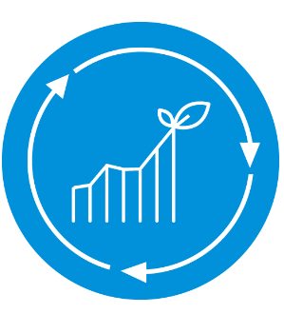

  The context provided by the Interreg Euro MED Programme
  The world is confronted with a more and more urgent need to accelerate the transition from a social and economic development model relying on excessive exploitation of natural resources to a more sustainable one, compatible with the planetary boundaries.
  The 2030 GreenerMed Agenda aims at accelerating the transition of the Mediterranean region towards a green, blue and inclusive economy
  There is growing consensus on the role of transformative place-based innovation to reach these ambitious targets. Innovation investment can be oriented to meet the most pressing challenges of sustainable development, beyond short-term economic growth.
  Complex challenges do not have obvious solutions, they require coordinated multilevel interventions by multiple actors guided by a directional goal and the transformation of the current socio-technical systems
  The Innovative Sustainable Economy Mission of the Interreg Euro-MED Programme works to boost a fair transition to a circular economy through two governance projects that develop innovative technical knowledge and ensure these new solutions are transferred into public policies

Slide 12
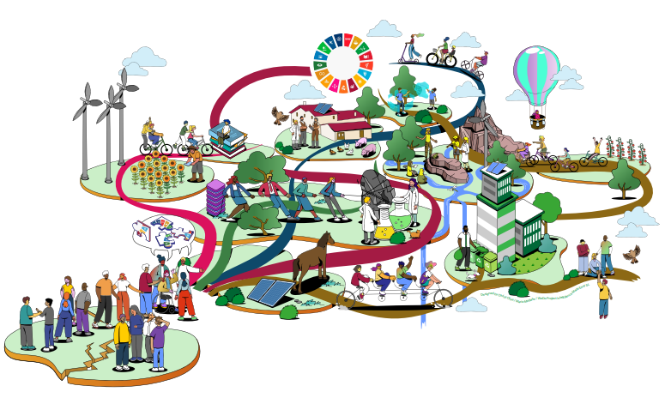
How do we envision this green and just transition in the MED?
  To accelerate green and just transitions we must address very complex place-based social, environmental and economic challenges
  No entity or actor can address those challenges from their area of ​​knowledge or their competences
  Complex challenges do not have obvious solutions, they require coordinated multilevel interventions by multiple actors guided by a directional goal

Slide 13
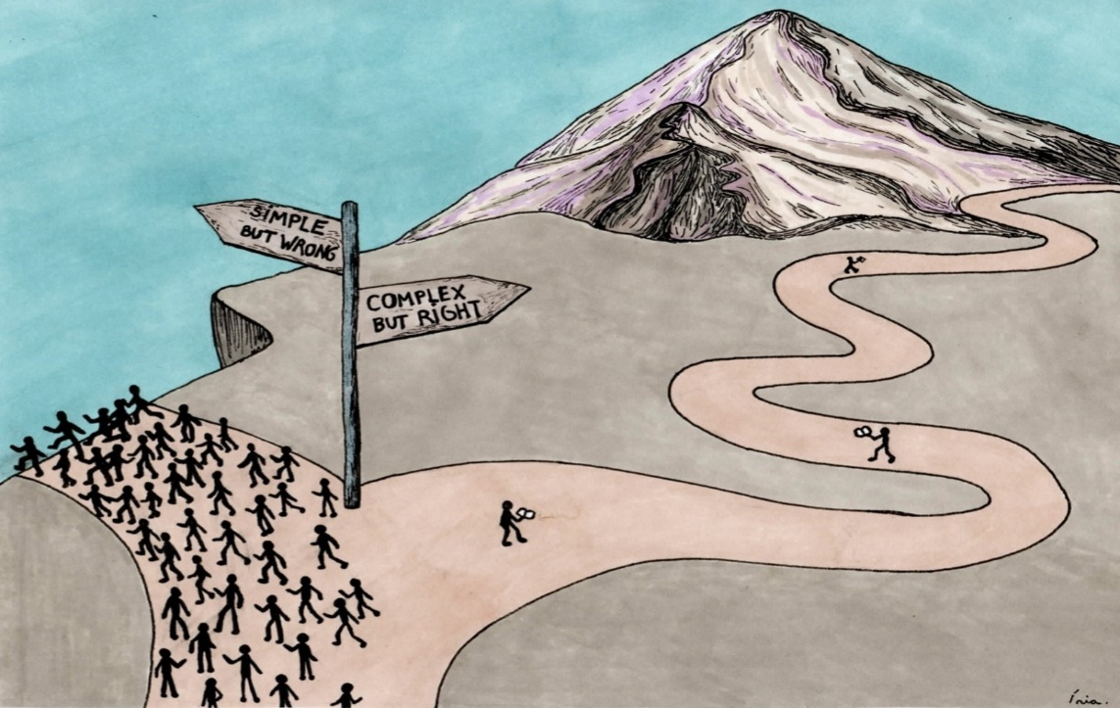

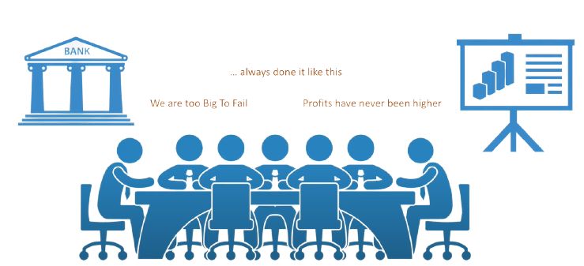
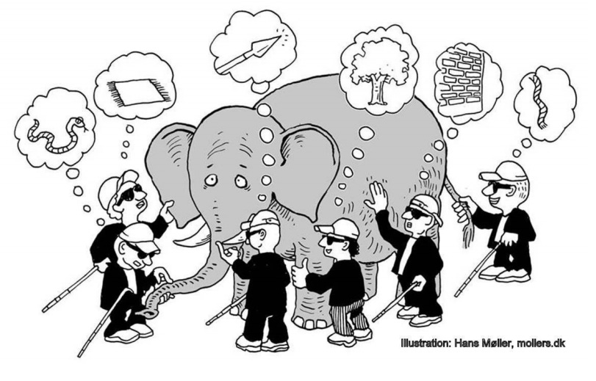
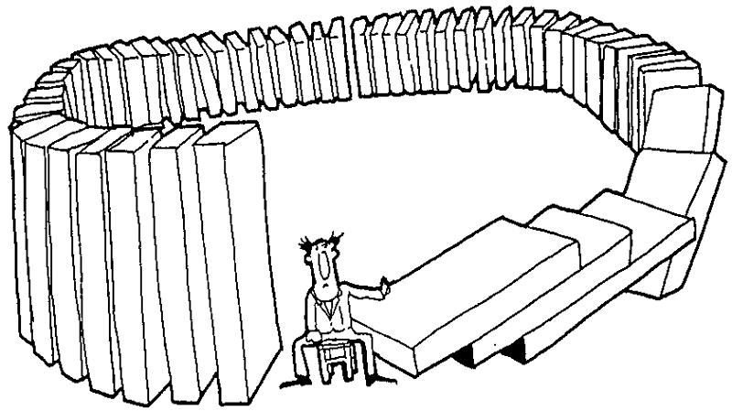
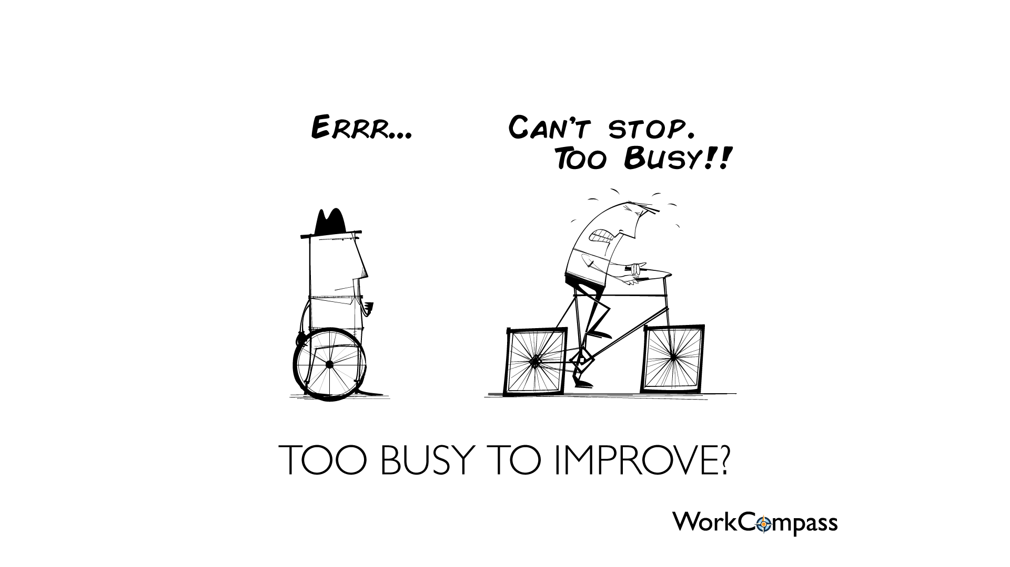
Why this systemic and transformative innovation approach?
Without it we’ll continue developing solutions for symptoms, which are relevant from our perspective. Solutions that do not go to the root of the problem and are not effective
Without it we will continue to apply solutions that we know do not work
https://www.systemsinnovation.io/post/two-loops-guide .
https://www.artsfwd.org/systems-thinking/.
https://commons.wikimedia.org/wiki/File:Too_Busy_To_Improve_-_Performance_Management_-_Square_Wheels.png

Slide 14
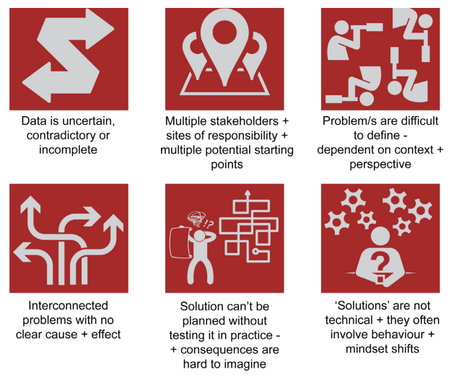
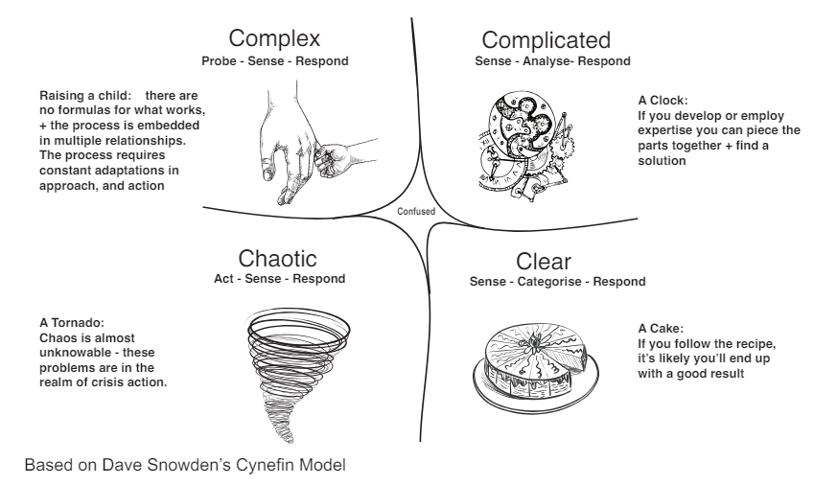
Sustainability challenges are complex problems requiring systemic approaches
Without a deep understanding of the problems and the actors affected, we won’t be able to address the challenges successfully
Source: Griffith Centre for Systems Innovation: Problem Framing Canvas

Slide 15
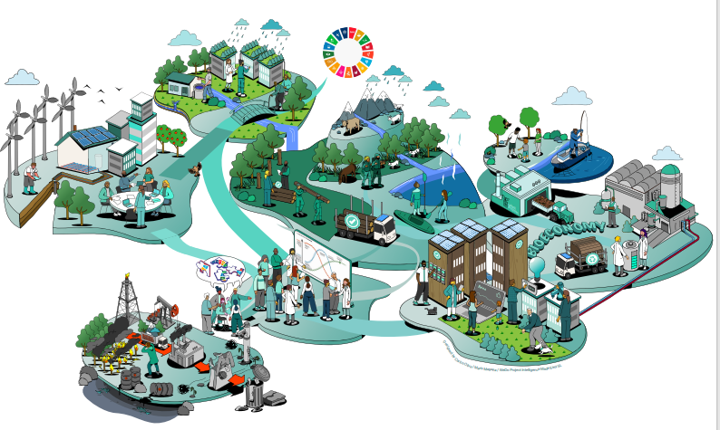
Where do we start?

Slide 16
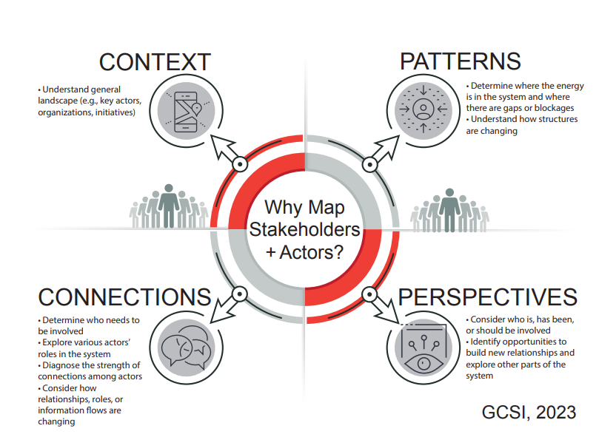
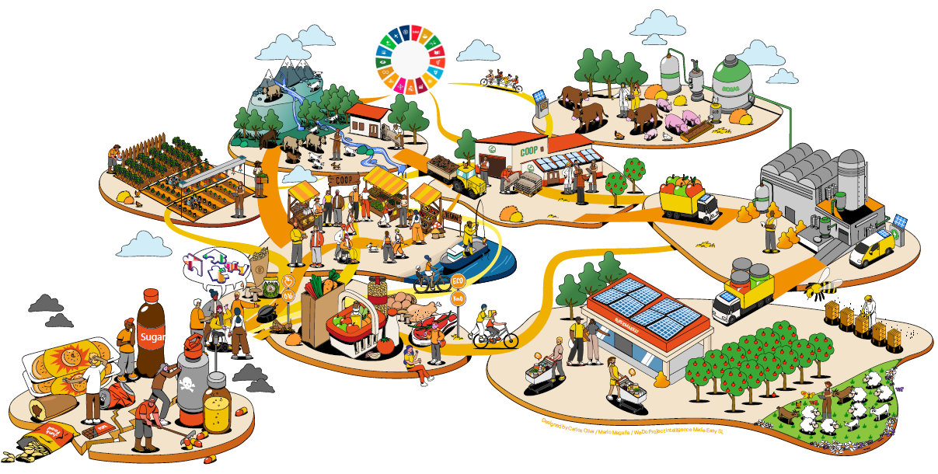
Where do we start?
Source: Griffith Centre for Systems Innovation: Problem Framing Canvas

Slide 17
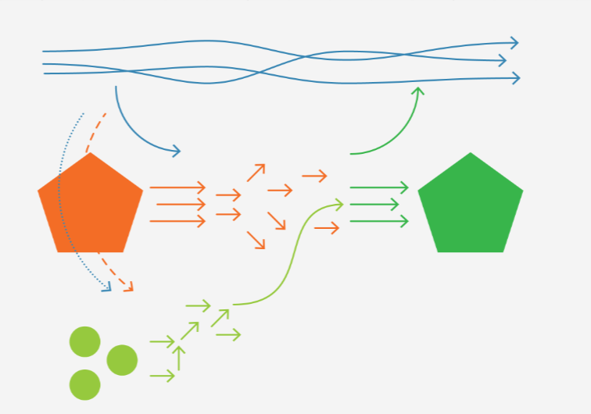

Multilevel perspective framework (MLP)
Global trends / landscape (aging of the population, climate change, digitalization, geopolitical tensions) generate pressure on the current dominant systems, destabilising them and opening windows of opportunity for alternative practices
Interactions between landscape, regimes, and niches are the main driver of systemic transformation
New regime
(new business as usual)
  Policies and governance
  Policies and governance
Current dominant regime: "business as usual" (policies, technologies, markets, social values, infrastructures) adapts slowly to global changes becoming dysfunctional and not delivering the expected results
  Investment and financing
  Society and culture
  Investment and financing
  Society and culture
  Markets
  Science, Technology and infrastructures
  Science, technologies and infrastructures
  Markets
Governments, through S3, can accelerate systemic transitions by nourishing and aligning niches and supporting the expansion and adoption of alternatives aligned with the shared vision of the future
EU and MED innovation and cooperation projects can accelerate the development and adoption of more sustainable alternatives
Emerging alternative practices (niches) with the potential to lead to the “new business as usual”
Time
Source: Adapted from TIPC, based on Geels and Schot (2007)

Slide 18

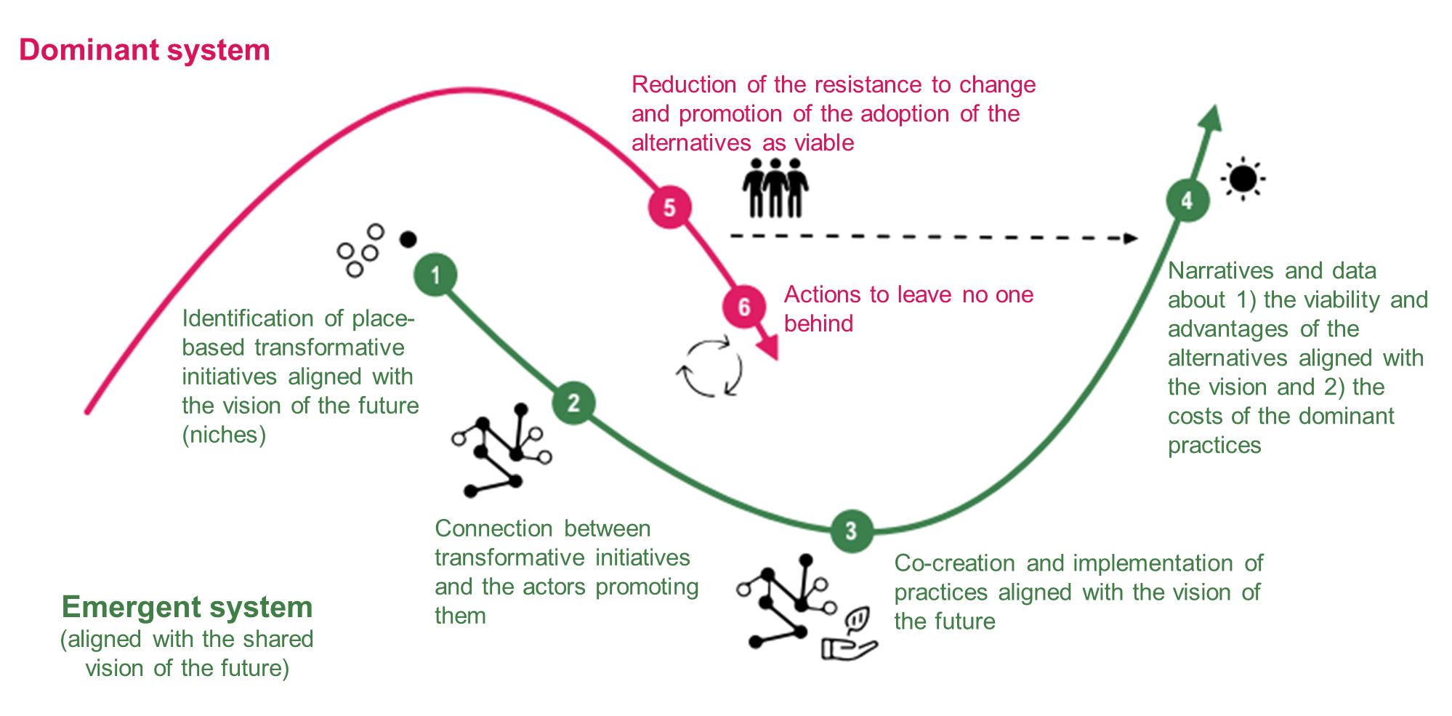
Supporting the emergence of a more sustainable “new business as usual” through the development and the adoption of alternatives that facilitate the transformation of the “current unsustainable business as usual”
Adapted from Berkana Institute

Slide 19
Place-based and challenge-led action for an innovative sustainable economy in the MED
  UNDERSTANDING THE PLACE-BASED CHALLENGE
    Stakeholders develop a shared systemic and MLP understanding of the problem they want to address
    Stakeholders define a shared vision of the future they want to work for and explore possible pathways
  ACTION: Stakeholders collaborate in experimental spaces to explore, develop, test and demonstrate alternatives aligned with the shared vision of the future
  LEARNING AND DIFFUSION OF ALTERNATIVES: generation of new knowledge and evidences facilitating the adoption of alternatives aligned with shared the vision of the future
  ADOPTION OF ALTERNATIVES: A NEW BUSINESS AS USUAL

Slide 20
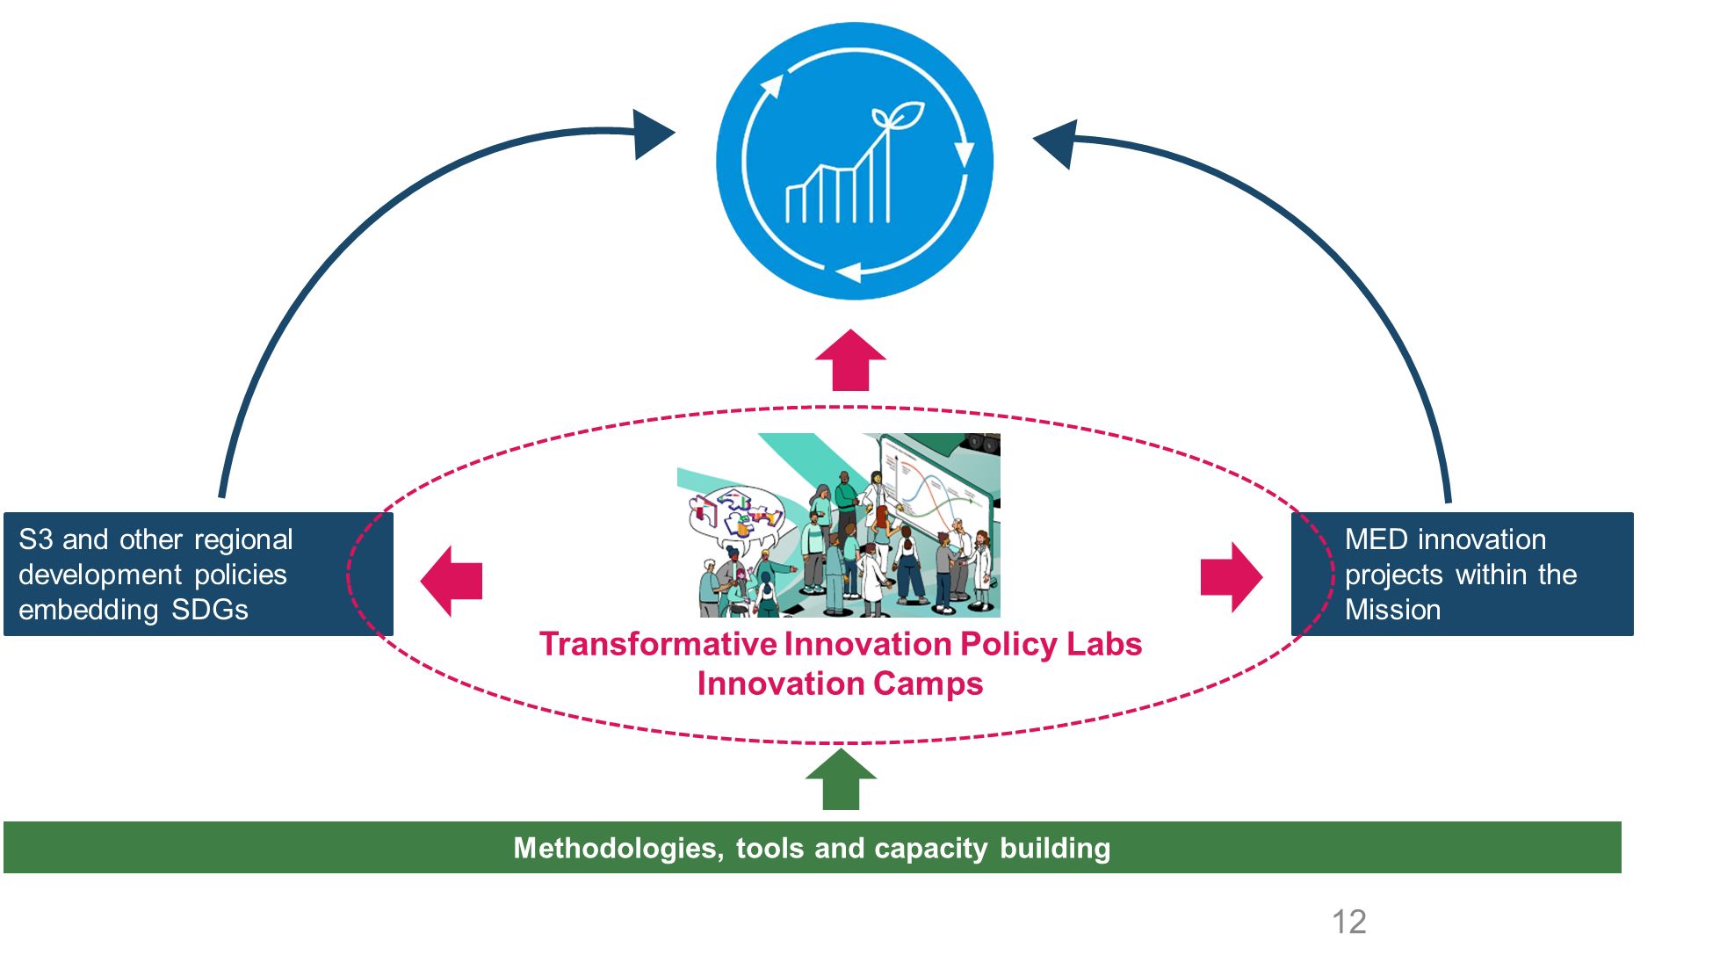
Place-based and challenge-led action for an innovative sustainable economy in the MED: Contribution of Dialogue4Innovation Project
  UNDERSTANDING THE PLACE-BASED CHALLENGE
    Stakeholders develop a shared systemic and MLP understanding of the problem they want to address
    Stakeholders define a shared vision of the future they want to work for and explore possible pathways
  ACTION: Stakeholders collaborate in experimental spaces to explore, develop, test and demonstrate alternatives aligned with the shared vision of the future
  LEARNING AND DIFFUSION OF ALTERNATIVES: generation of new knowledge and evidences facilitating the adoption of alternatives aligned with shared the vision of the future
  ADOPTION OF ALTERNATIVES: A NEW BUSINESS AS USUAL

Slide 21
  Today
  Keynote: Aligning S3 with a Sustainable Innovative Economy (SDGs): what does imply?
  Introduction of frameworks and tools to work with complex challenges and to accelerate green and just transitions
  Discovering the potential for creating synergies between challenge-driven MED S3 and challenge-driven Interreg Euro MED innovation projects within the Mission Innovation for a Sustainable Economy
  Testing the frameworks and tools on the challenge of rural and remote regions.
  Tomorrow
  Exploring the opportunities to amplify the impact of Interreg Euro MED innovation projects and MED S3
  How can the Dialogue4Innovation Project support this process?
  Co-designing the Transformative Innovation Policy Labs

Slide 22
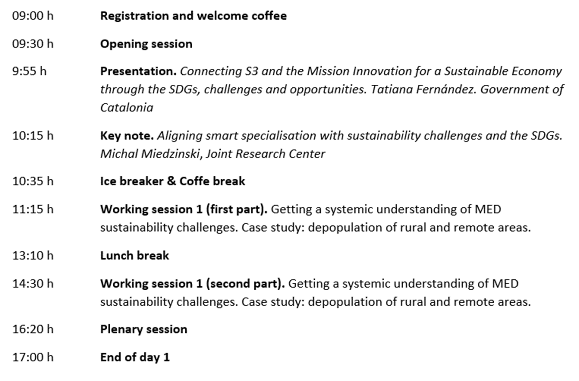
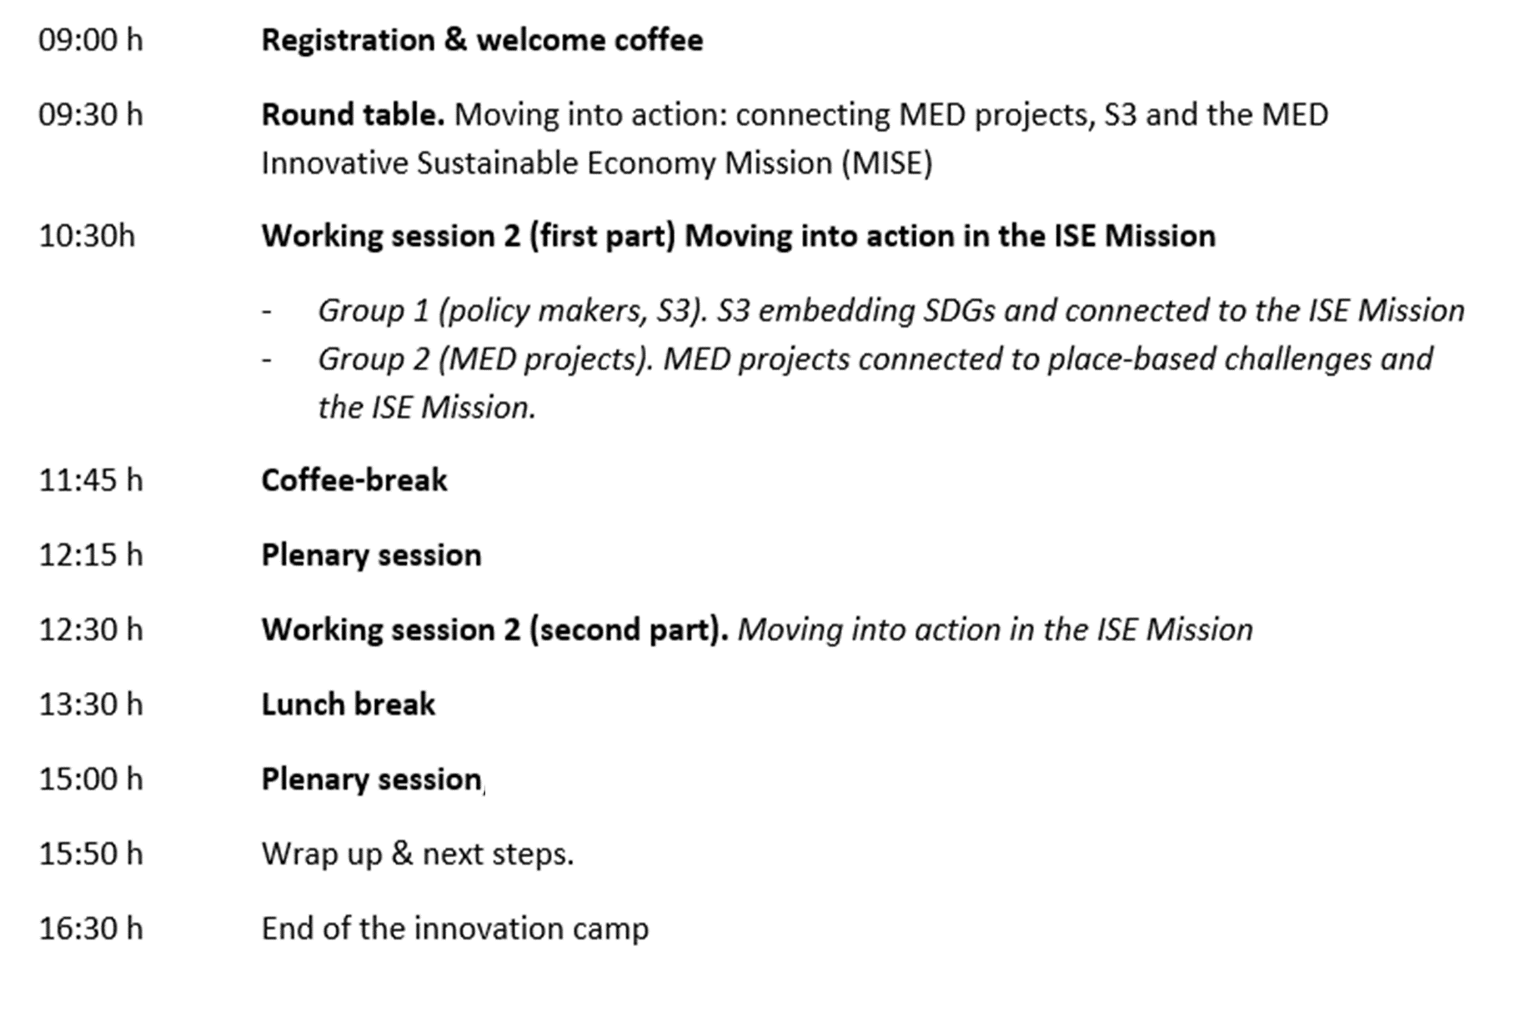
Today’s agenda
Tomorrow’s agenda

Slide 23
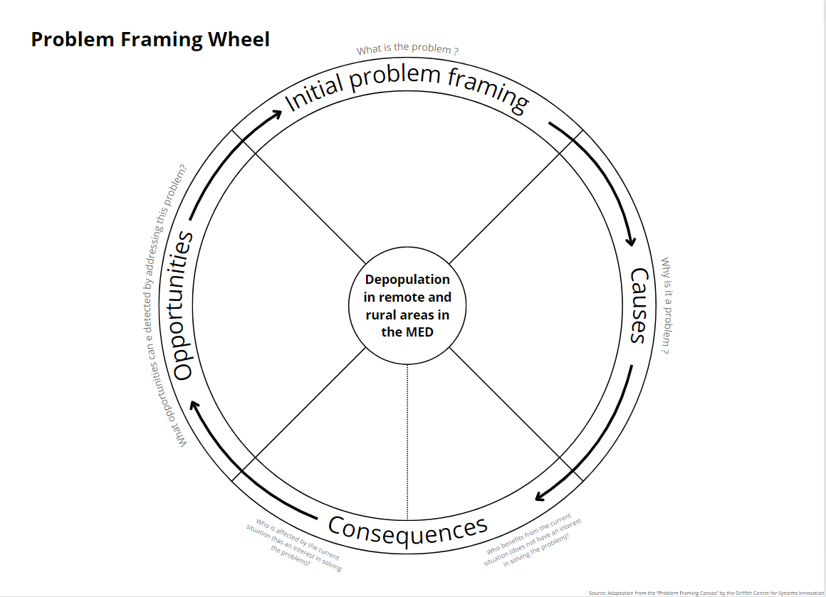
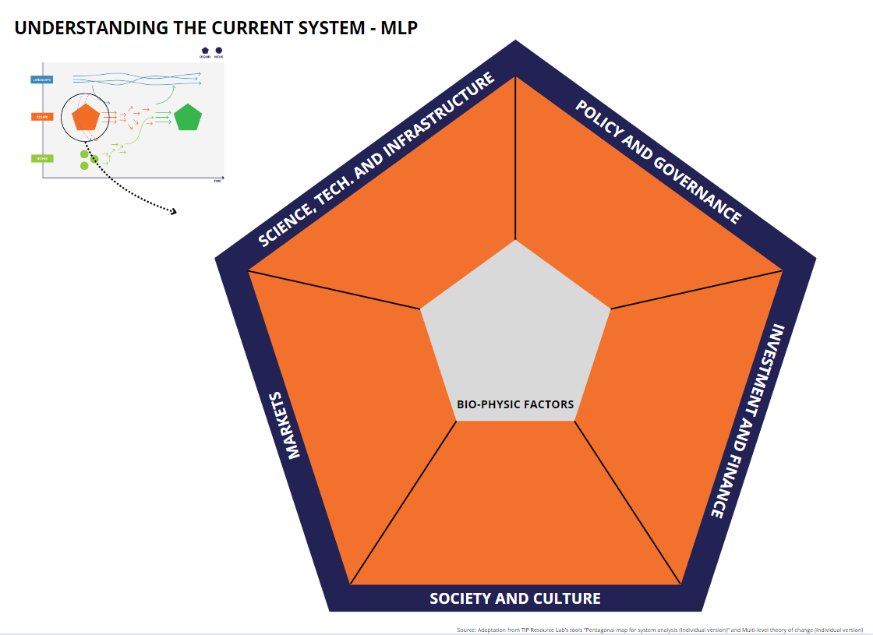
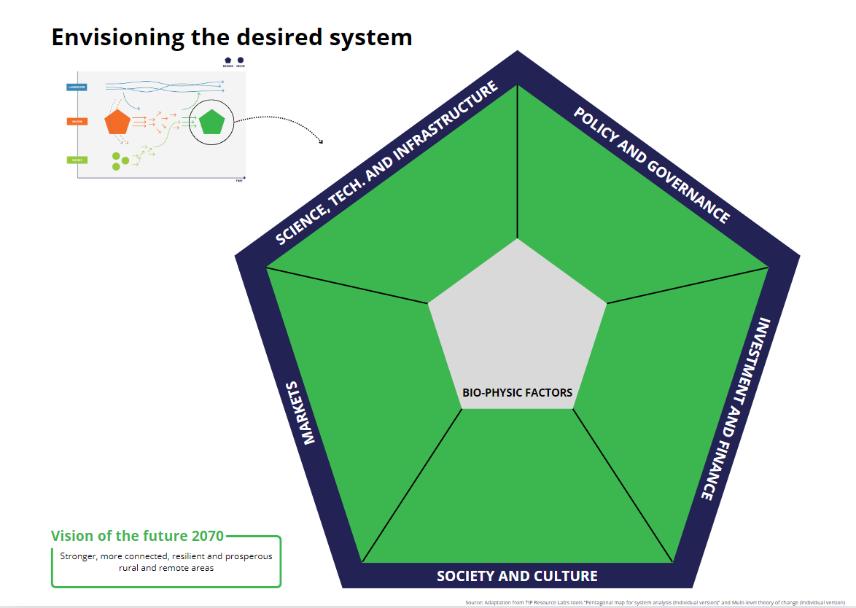
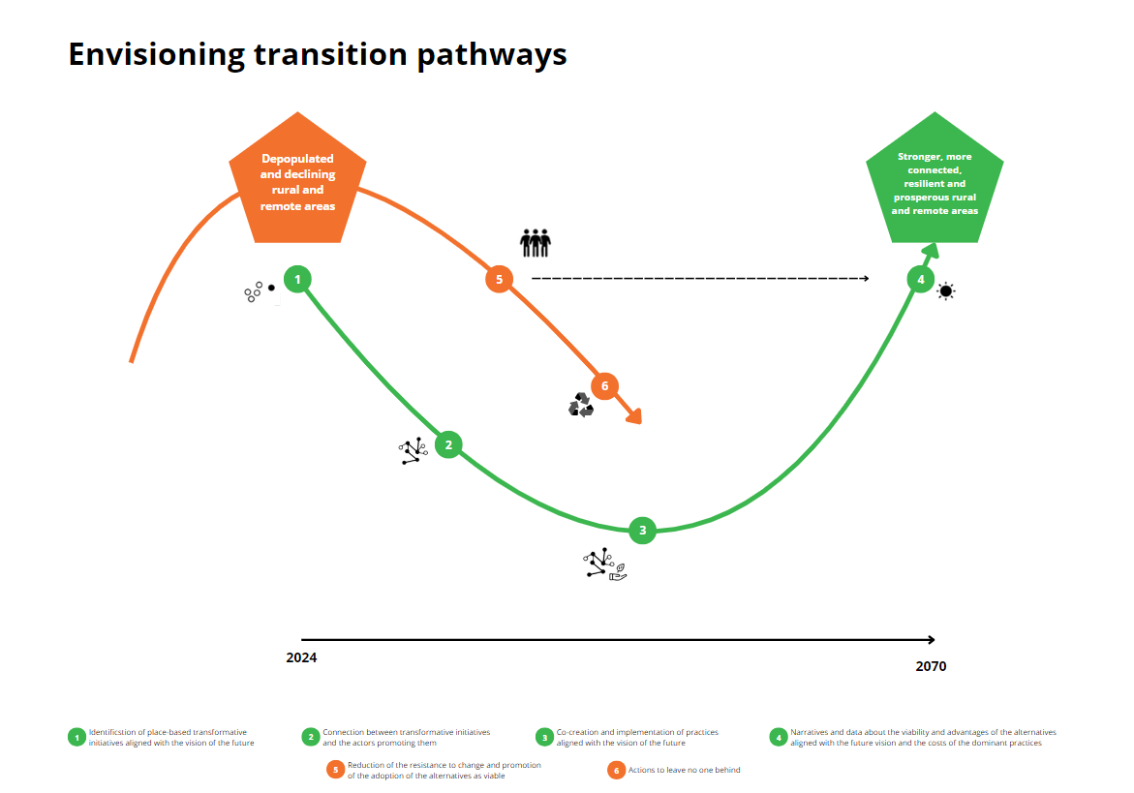
TODAY
2024: Understanding the complex problem of depopulation in remote and rural areas
2024: Understanding the different dimensions of the system causing the problem and the resistance of the system to change
2070: envisioning the system’s dimensions of stronger, more connected, resilient and prosperous rural and remote areas
2024 - 2070: envisioning how we have achieved stronger, more connected and prosperous rural and remote areas

Slide 24
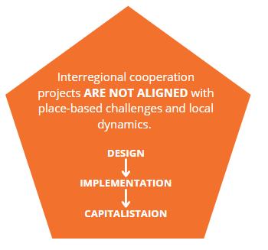
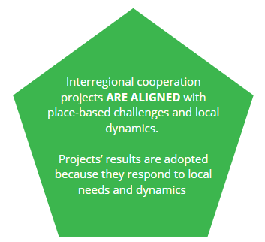
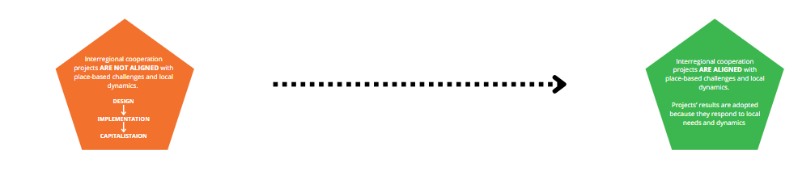
TOMORROW

Slide 25
TOMORROW

Slide 26
Aligning smart specialisation with sustainability challenges and the SDGs
Conceptual framework and lessons from policy practice
Michal Miedzinski
Barcelona, 28-29 May 2024

Slide 27
This presentation
Setting the scene: smart specialisation and the SDGs
  Aligning S3 with the SDGs: lessons from literature
  Aligning S3 with the SDGs: lessons from policy practice
Closing remarks
Source: Miedzinski et al. 2021

Slide 28
Smart specialisation and the SDGs

Slide 29


2030 Agenda: a call for systemic transformation
Source: United Nations

Slide 30

Welcome to Planet Earth
Credit: Apollo 17 Crew, NASA

Slide 31
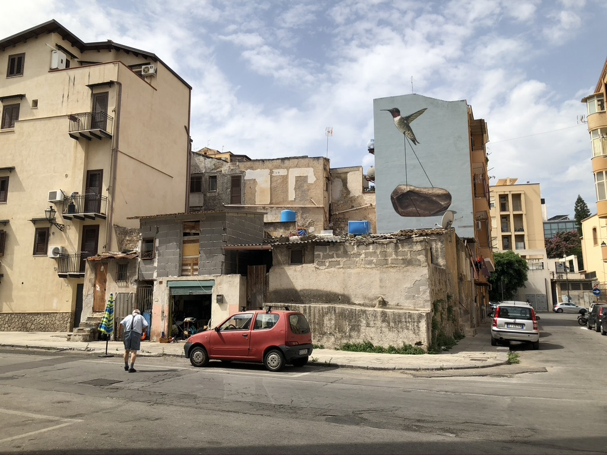
Palermo
Source: Photo by Michal Miedzinski

Slide 32
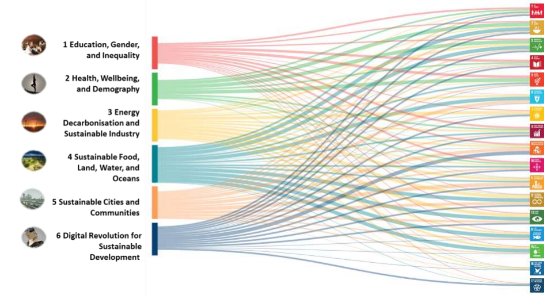
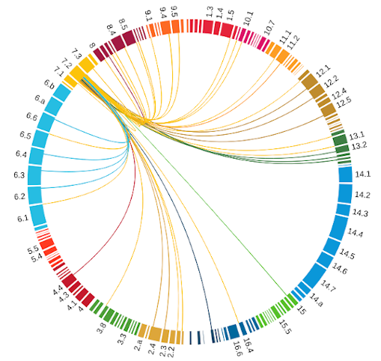
Systemic transformation towards the SDGs
Source: JRC
Source: UN SDSN 2019, Sachs et al., 2019

Slide 33

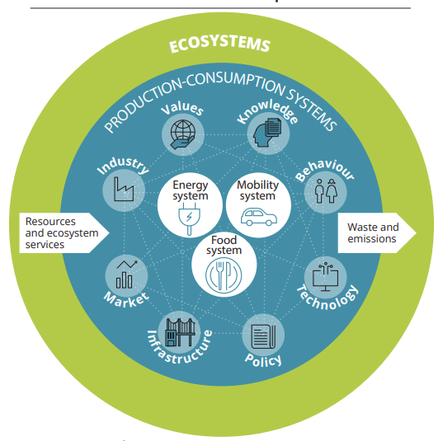
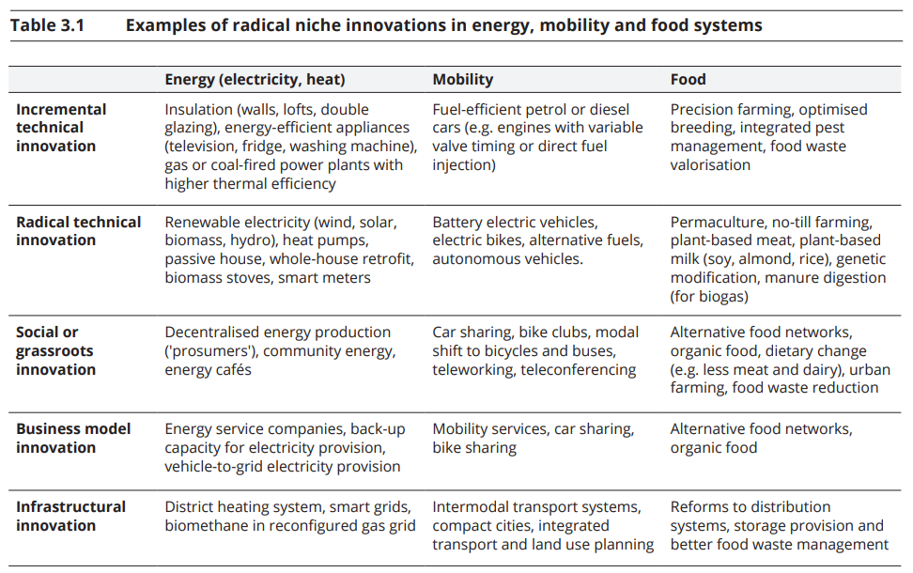
Innovation for systemic change
Source: European Environment Agency, 2019

Slide 34
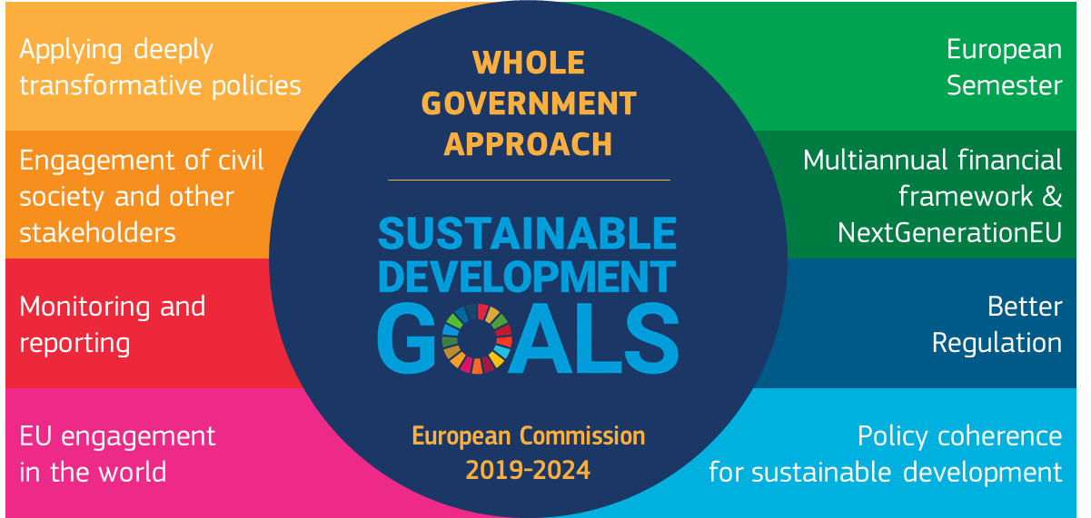
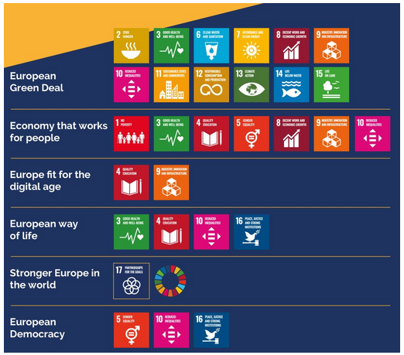
EU policy priorities to align with the SDGs
Source: EU Voluntary Review
Notes:
The European Commission is implementing the 2030 Agenda through a ‘whole-of-government’ approach, integrating the SDGs into all proposals, policies and strategies. Since 2020, the Commission’s annual work programmes have put the SDGs at the heart of EU policymaking. They are reflected in particular in flagship initiatives such as the European Green Deal and NextGenerationEU. These involve large amounts of funding, for example through the Recovery and Resilience Facility to support reforms and investments that concretely contribute to making progress on SDGs. The European Commission has also integrated the SDGs in the European Semester, the EU’s framework for economic and fiscal policy coordination.

Slide 35
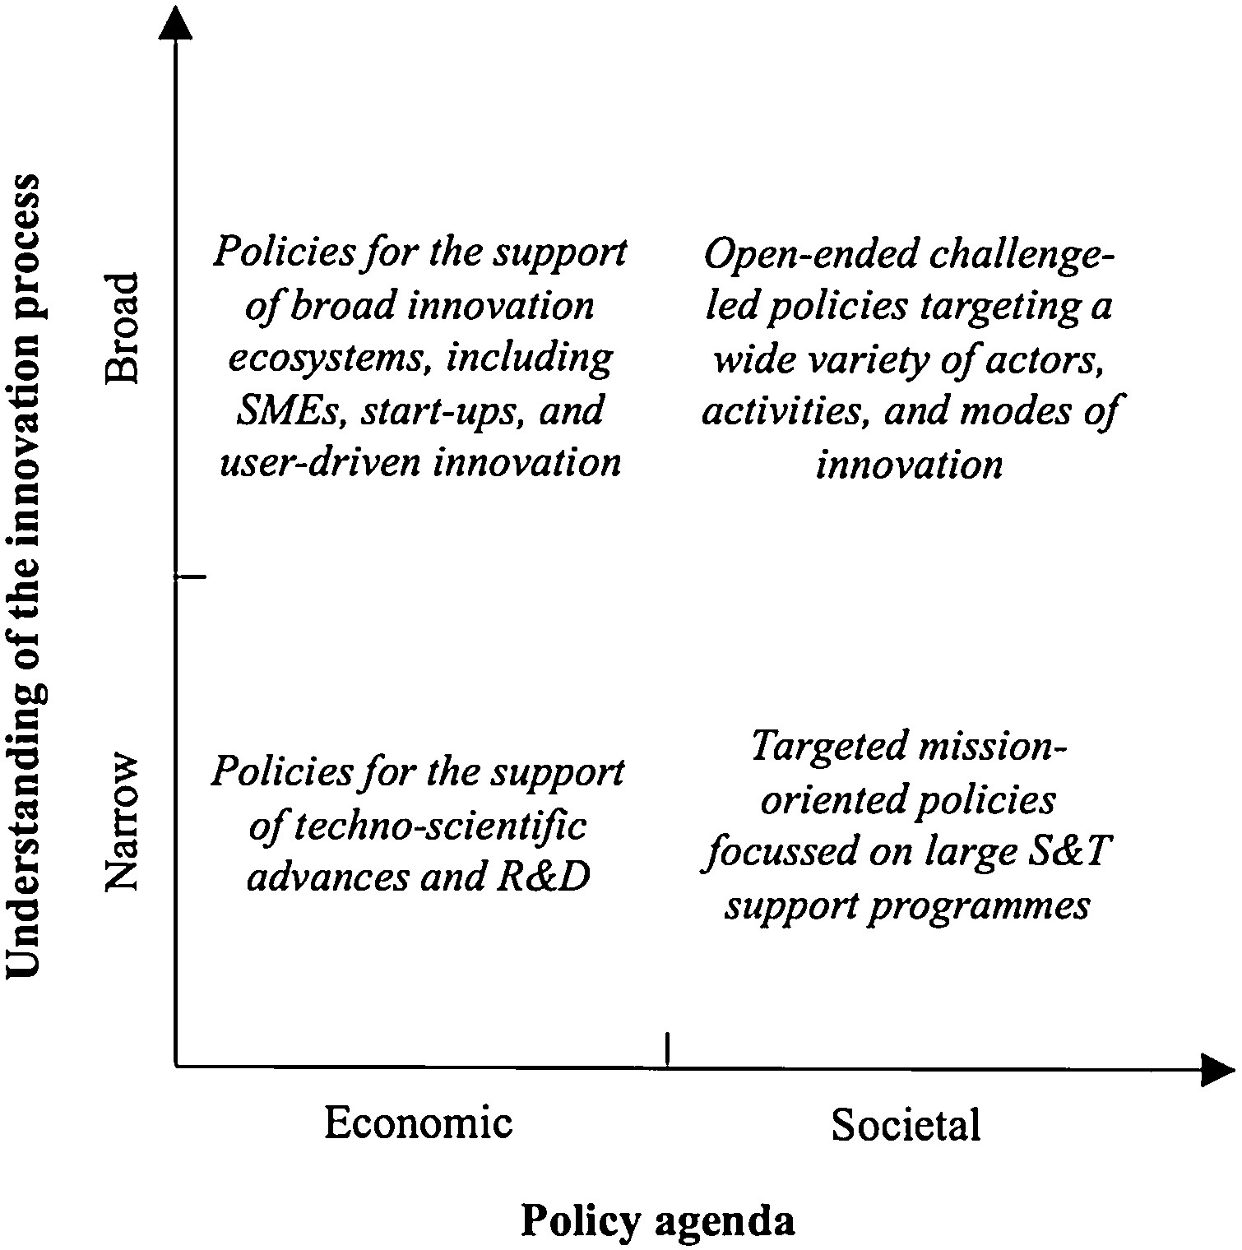
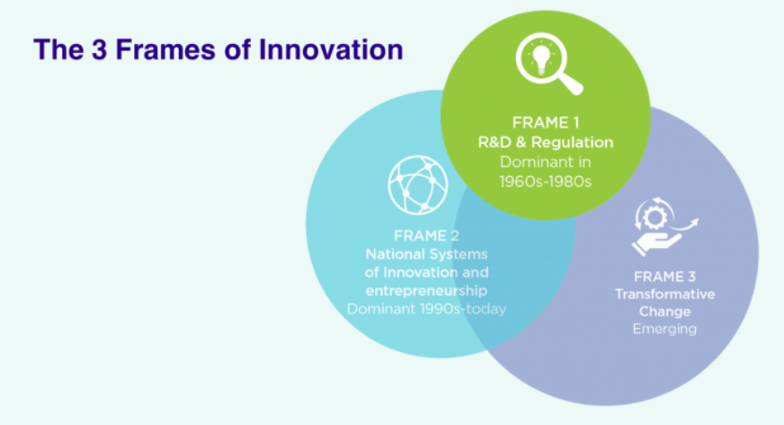
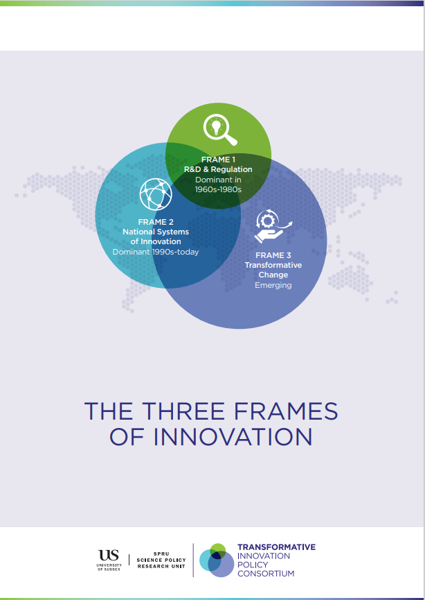
Revisiting boundaries of innovation policy
Research and innovation (R&I) policies are broadening their scope from supporting R&D and innovation systems towards challenge-oriented approaches contributing to transformative change.
The shift towards challenge-oriented R&I policy broadens the understanding of innovation and widens the R&I policy agenda.
Source: Diercks et al. 2019

Slide 36
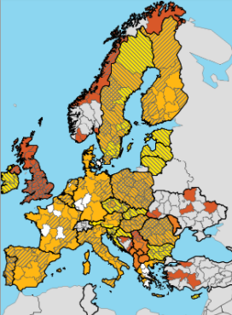
Smart specialisation
Smart specialisation (S3) strategies are integrated, place-based economic transformation agendas:
Focused on policy support and investments in key priorities, challenges and needs for knowledge-based development
Built on territorial strengths, competitive advantages
and potential for excellence
Supporting technological and practice-based innovation
and aim to stimulate private sector investment
Engaging stakeholders involved in innovation and experimentation
Evidence-based with sound monitoring and evaluation system.
S3 was inspired by evolutionary economics and evolutionary approaches to industrial and innovation policy. Since the early 2010s it has become a central approach underpinning regional innovation strategies and innovation-oriented operational programmes of EU Cohesion Policy.

Slide 37
Challenges for aligning S3 with the SDGs
Political and policy challenges
  S3 belongs to a family of economic policies concerned primarily with economic growth and competitiveness, often at the expense of a more decisive action for sustainability
  Directionality and system-level change towards sustainability not embedded in S3:
  few strong positive or negative policy incentives to align S3 with the SDGs.
Conceptual challenges
  Possible disconnect between the choice of S3 priority areas and the local problems and opportunities driven by sustainability challenges
  Tensions between the principles of the Agenda 2030 and the rationale underlying S3
  Entrepreneurial discovery process (EDP) not equipped to foster challenge-oriented approaches to exploring alternative innovation pathways towards sustainability
Implementation challenges
  Implementation bottlenecks in institutionally and structurally weaker regions
  Policy mix usually limited to supply side instruments supporting R&D and innovation
  Governance and EDP rarely include civil society and citizens or vulnerable groups.

Slide 38
Aligning S3 with the SDGs
Lessons from literature

Slide 39
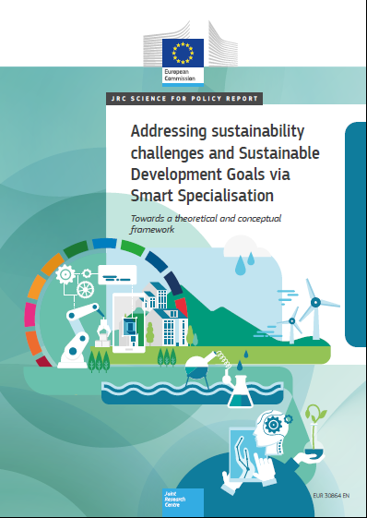
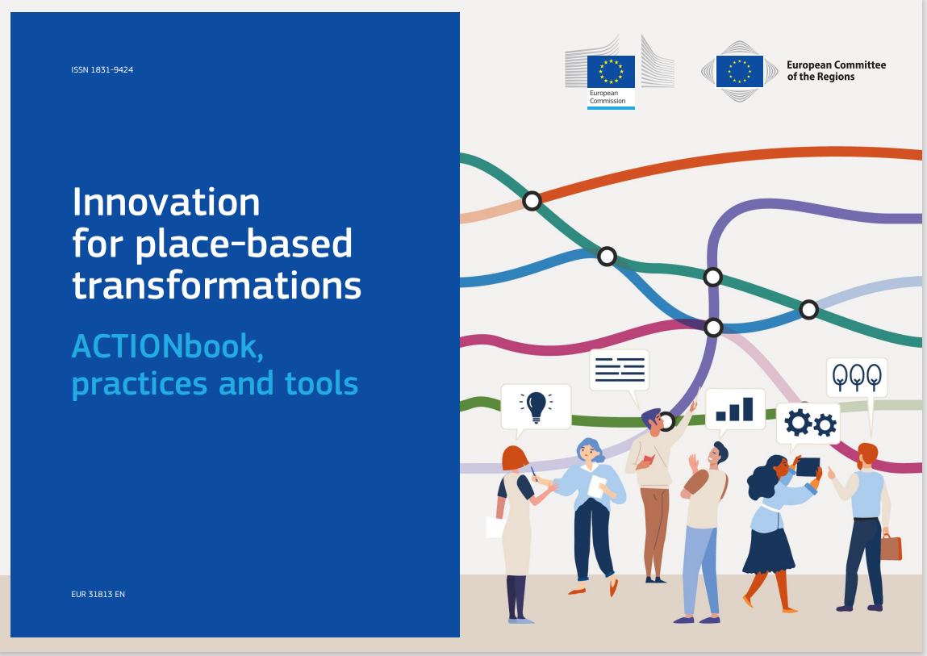
Towards the S3 for SDGs approach
Aim: reflect and make concrete suggestions on how smart specialisation can help territories in Europe and beyond address sustainability challenges and contribute to the policy agendas of the European Green Deal and the UN 2030 Agenda for Sustainable Development.
Approach: comprehensive literature review and interviews with selected academic researchers to understand different perspectives on integrating sustainability-related aspects and goals in S3.

Slide 40
Drawing lessons for S3 from research on sustainability transitions
Perspectives | Core concepts | Examples of papers combining place-based innovation, transition and sustainability
Sociotechnical transitions | Sociotechnical system Multi-level perspective (MLP) Transition pathways Experimentation | Truffer and Coenen (2012) Coenen et al. (2012) Wieczorek et al. (2015) Hansen and Coenen (2015) Kivimaa et al. (2017) Sengers et al. (2019) Veldhuizen (2020) Binz et al. (2020)
Social-ecological resilience | Social-ecological system Transformational resilience Social learning | Eriksen et al. (2011) Brown (2014) Biggs et al. (2012, 2015) Colvin et al. (2014) Wamsler et al. (2014) Elmqvist et al. (2019) Bevilacqua et al. (2020) Castro-Arce and Vanclay (2020)
Challenge-led innovation policy | Transformational failures Transformative innovation policy Mission-oriented innovation policy Responsible research and innovation Policy mix for sustainability transitions | Weber and Rohracher (2012) Foray (2018) Tödtling and Trippl (2018) Magro and Wilson (2019) Fitjar et al. (2019) Uyarra et al. (2019) Thapa et al. (2019) Wanzenböck and Frenken (2020) Panciroli et al. (2020)
  We focused on three interdisciplinary research fields focused on system change:
  Sociotechnical transitions
  Social-ecological resilience
  Challenge-oriented innovation policy.
  We conducted a comprehensive review and focused reflection on concrete lessons these areas of research offer for revising the S3 framework and process to better align it with the SDGs and the transformative ambition of the 2030 Agenda.
Source: Miedzinski et al. 2021

Slide 41
Drawing lessons for S3 from research on sustainability transitions (2)
  Example: Insights from the literature for the S3 governance
Limitations of the S3 model | Insights from sociotechnical transitions | Insights from social-ecological resilience | Insights from challenge-oriented innovation policy
Limited inclusion of civil society and vulnerable groups Insufficient arrangements for the continuous discovery, experimentation and learning Insufficient interregional coordination to address sustainability challenges. | Ensure inclusivity of the process. Reflect on the roles, interests and expectations of incumbent and niche actors in S3 governance (e.g., to anticipate and manage capture of the process by incumbents). | Ensure inclusivity of the process, especially to include previously excluded or underrepresented groups. Engage local actors to develop shared ownership of S3 and localise the SDGs. | Facilitate challenge-oriented or mission-led collaboration for transformative innovation and the SDGs. Support inclusive governance, ensuring the participation of civil society and citizens.
Source: Miedzinski et al. 2021

Slide 42
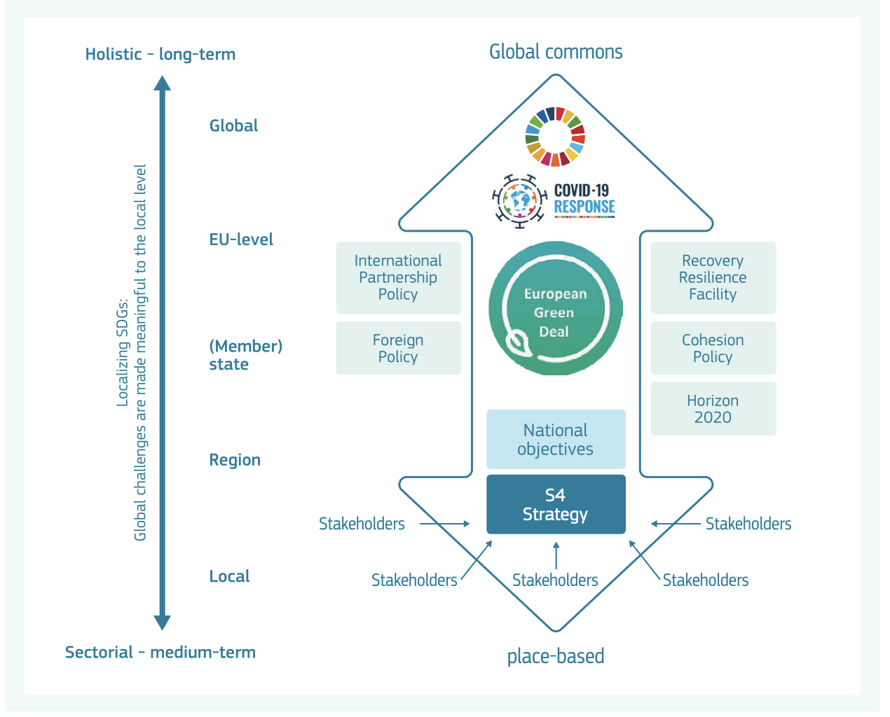
S3 for the SDGs: “policy space” where directionality is deliberated by top-down and bottom-up dynamics
Smart specialisation
Source: Nakicenovic et al, 2021

Slide 43
Principles of S3 for the SDGs
Shared direction towards the SDGs | SDGs as an overarching strategic framework of smart specialisation giving a shared direction and the sense of urgency to the discovery process and the selection of S3 priorities
Whole-system transformation towards sustainability | Foster innovations contributing to wider sociotechnical and social-ecological transitions needed to accomplish the SDGs Embrace complex, multi-actor, multi-scalar and often uncertain nature of sustainability transitions
Responsibility and reflexivity | SDGs as a compass helping S3 to navigate difficult ethical and moral choices while considering short- and long-term sustainability impacts of its priorities and actions Nurture learning and reflexivity about possible impacts of transition on vulnerable groups and territories (‘just transitions’)
Source: Miedzinski et al. 2021

Slide 44
Implications of embedding sustainability in S3
 | =
 | S3 principles | Shared direction towards the SDGs | Whole-system transformation | Responsibility and reflexivity
Principles of Smart Specialisation | Choices, prioritisation and critical mass | Smart Specialisation priorities to build and harness ‘critical mass’ of the regional research and innovation potential and interregional and international partnerships to address sustainability challenges. | Focus on a broader suite of social and technological innovations with the potential to foster systemic transformation of the region towards more sustainable modes of production and consumption. | Choice of S3 priority areas and transition pathways to be underpinned by an assessment of economic, social and environmental impacts and value created inside and outside the region.
 | Competitive advantage | Ensure that developing a competitive advantage does not come at external costs - or does not create future pressures - for society and the environment inside and outside the region | Focus on creating value for local communities and economies by transforming unsustainable systems of production and consumption. The transformation should contribute to social-ecological resilience locally and globally. | Reflect on potential implications of strategic choices driven by building competitive advantage of the region for social groups and natural environment in regions potentially adversely affected by these decisions.
 | Connectivity and clusters | Provide incentives to develop a shared vision and alignment with the SDGs. This alignment should create synergies and define single territorial contributions to the wider 2030 Agenda for Sustainable Development. | Develop challenge-led or mission-oriented partnerships, clusters and networks engaged in emerging niches or promising demonstrations of transformative innovation addressing sustainability challenges. | Ensuring the new challenge-oriented or mission-oriented partnerships, clusters and networks include broader set of stakeholders (quadruple helix) and are not captured by incumbents with vested interests in status quo.
 | Collaborative leadership | Ensure political commitment and leadership to mobilise collective action and embrace the sustainability orientation of the 2030 Agenda for Sustainable Development and the SDGs. | Experimenting with new forms of entrepreneurial discovery and collaborative leadership and forms of governance suitable for orchestrating long-lasting multi-actor and multi-level processes of change. | Ensure that decisions taken on priorities and transition pathways, as well as the forms of leadership and governance of transitions, have a broad social mandate.
Source: Miedzinski et al. 2021

Slide 45
Aligning S3 with the SDGs
Lessons from policy practice and action research

Slide 46
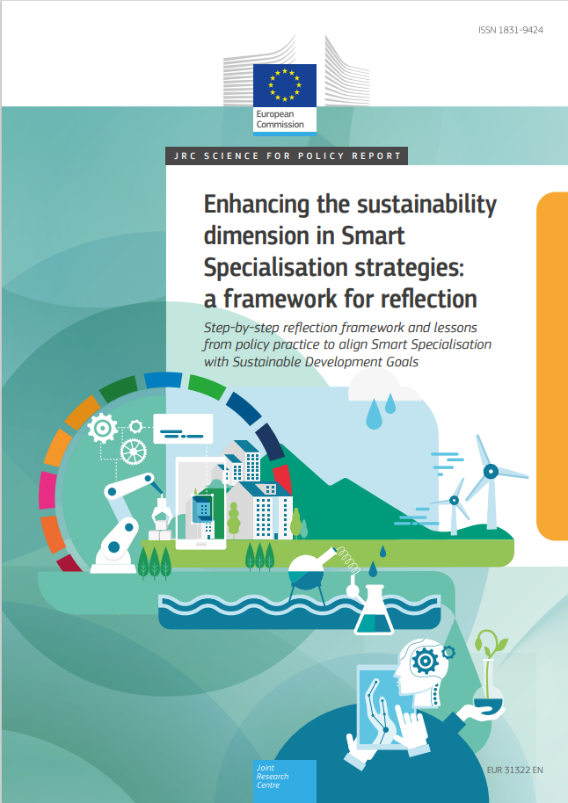
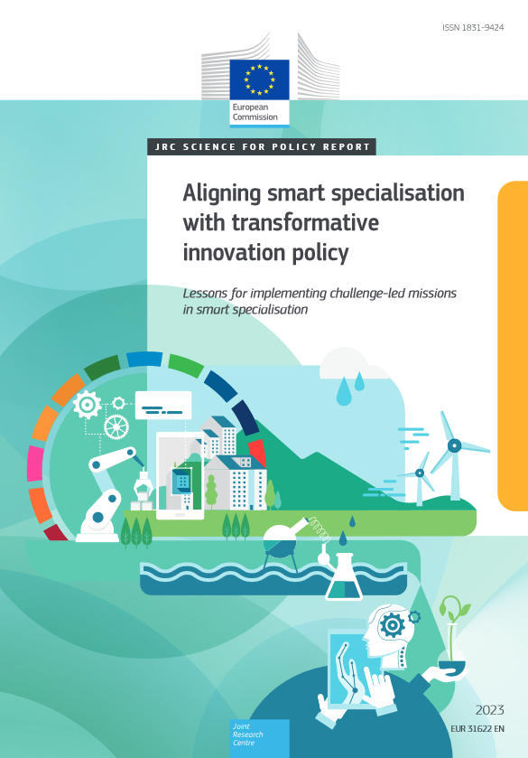
Lessons from policy practice
Aim: develop guidance and collect examples on how to align S3 for SDGs; support policy processes aimed to align S3 with challenge-oriented policy (e.g. missions).
Approach: interviews with selected regions and countries in the EU and beyond to understand different perspectives and experiences of integrating sustainability-related aspects and goals in S3; action research in a close collaboration with policy makers (e.g. Czechia).
Source: Miedzinski et al. 2022, Reid et al. 2023

Slide 47
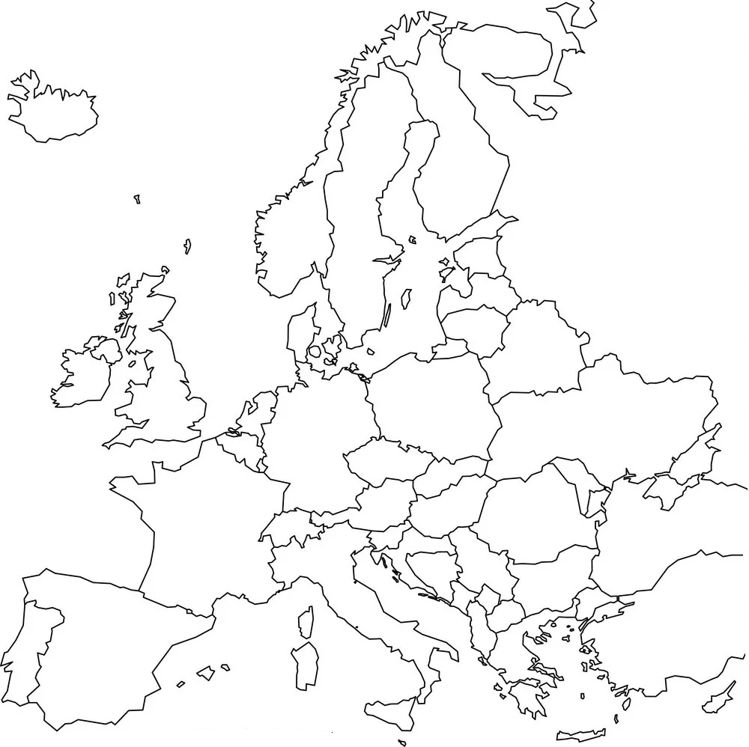
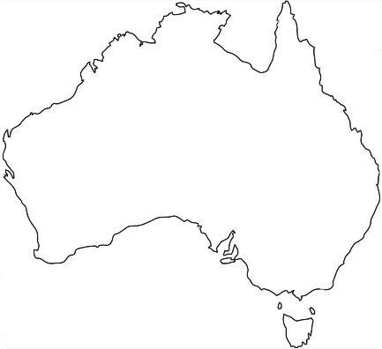
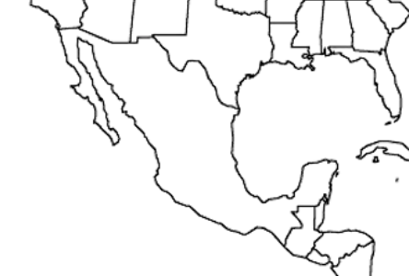
Co-creation with policy practitioners from EU and beyond
Australia, Gippsland
Belgium, Wallonia
Czechia
Finland, Lapland
France, Hauts-de-France
Mexico, Hidalgo
Netherlands, Northern Netherlands
Norway, Vestland
Poland, Pomorskie
Portugal, Centro
Romania, North West
Spain, Basque Country.
Workshops had three sessions: (1) experiences of integrating sustainability in Smart Specialisation, (2) feedback on reflection framework of Smart Specialisation for the SDGs, (3) self-assessment tool for strengthening the sustainability dimension of S3.
Source: Miedzinski et al. 2022

Slide 48
Reflection framework: a formative policy tool
Formative tool created to assist policymakers, practitioners
and analysts in reflecting on how to localise and integrate sustainability challenges and goals in smart specialisation.
Comprehensive approach to embed sustainability throughout
the policy cycle and the S3 steps
Questions to guide reflection and self-assessment of the current S3
Challenges and opportunities of re-orienting innovation policies and S3 towards sustainable development
Lessons learned and concrete examples of existing practices collected from S3 practitioners
Selected reading and learning resources.

Slide 49
Diagnosis
Questions to guide reflection and self-assessment
Does the diagnosis include evidence on the current and potential future impacts and risks for your territory associated with global environmental and societal challenges?
How do you collect and interpret different types of evidence and data on sustainability challenges and opportunities to support the design and implementation of Smart Specialisation strategy?
How inclusive is the diagnostic process? Does the diagnosis consider diverse perspectives on the societal challenges, including from previously not involved or marginalised groups?
Does the analysis of the existing specialisation areas and competitive assets of your territory include evidence on the strengths and weakness of actors, institutions and infrastructures to adapt and innovate to address sustainability challenges and the SDGs?
Challenges for diagnosis
Identify current, emerging and future localised impacts and risks associated with sustainability challenges for the regional economy and technical infrastructure, local communities, and natural environment.
Map and assess territorial research and innovation potential and capabilities to anticipate, adapt and innovate to address localised sustainability challenges.
Develop robust evidence base including scientific knowledge, diverse local expertise and stakeholder perspectives on the localised challenges and the SDGs, including views held by vulnerable groups.
Lessons and case studies
Reflections and examples from the Northern Netherlands (NL), Gippsland (AU), Serbia, Vestland (NO)
Source: Miedzinski et al. 2022

Slide 50
Governance
Questions to guide reflection and self-assessment
Do the design, implementation and monitoring of S3 ensure a broad, inclusive and continuous participation of stakeholders relevant to the sustainability transformation of your region or country?
What are the specific arrangements for identifying and addressing the risk of capture of the process by dominant incumbents who impose their perspectives on sustainability transition or are less concerned with sustainability objectives?
Are there governance mechanisms within and across public and private sectors that allow the identification and generation of inter-institutional synergies between policies, instruments and budgets?
Challenges for governance
Broaden participation in S3 governance to engage new actors, including civil society. Broader inclusion is key for ensuring shared ownership and legitimacy of the process and helps to prevent the risk of capture. Engaging new actors can help translate SDGs into specific local (or trans-local) measures and missions.
Strengthen institutional capacity and build new transformative capabilities in public sector to ensure challenge-led collaborative governance in S3.
Reconsider the role of intermediaries in engaging difficult-to-reach groups and previously excluded groups and territories.
Lessons and case studies
Reflections and examples from Basque Country (ES), Gippsland (AU), Ukraine.
Source: Miedzinski et al. 2022

Slide 51
Vision
Questions to guide reflection and self-assessment
What is the importance of sustainability challenges and the SDGs in the S3 vision and visions underpinning other relevant development strategies of your region or country?
How is desirable future portrayed in the S3 vision? What is the relative importance of economic, social and environmental dimensions in the vision?
Is the vision known and shared by the key stakeholders?
Does S3 include a reflection on alternative development scenarios and transition pathways to explore the role of research and innovation in achieving sustainability goals? Does the reflection on alternative pathways consider their potential economic, social and environmental impacts?
Challenges for developing vision
Develop a shared territorial vision based on the systemic reflection on the opportunities, risks and uncertainties of sustainability transitions.
Focus the vision and scenarios on the role of research and innovation in fostering alternative transition pathways towards the SDGs.
Use foresight tools to deliberate alternative transition pathways considering the role of variety of innovation approaches to tackle sustainability challenges.
Consider developing scenarios and transition pathways for each specialisation (priority domain) of the region. This can create a more active engagement of stakeholders in the process and becomes part of a challenge-led EDP.
Lessons and case studies
Reflections and examples from Basque Country (ES) and the Northern Netherlands (NL)
Source: Miedzinski et al. 2022

Slide 52
Priorities
Questions to guide reflection and self-assessment
Were societal challenges taken into account in the definition of your S3 priority domains? If yes, how do they address sustainability challenges and the SDGs?
What are the incentives, drivers and barriers for including sustainability-related specialisation areas and objectives, including the SDGs, in the S3 priorities?
How do you balance top-down goals and bottom-up perspectives in selecting and shaping your priority domains? What is the role of EDP in this context?
Do any of the selected S3 priorities focus on existing or emerging niches with a potential to experiment, demonstrate or scale transformative innovation with an ambition to address sustainability challenges and the SDGs in your region or country?
Challenges for setting priorities
Focus priorities on challenge-oriented domains to ensure that S3 mobilises research and innovation potential to respond to sustainability challenges
Ensure a dynamic balance between top-down identification of priorities with bottom-up entrepreneurial discovery. The bottom-up processes of discovery and social learning are essential for situating sustainability goals in the regional context.
Consider adopting a challenge-oriented approach to EDP to align it with the directionality towards sustainability challenges and harness bottom-up ideas for transformative innovations and experimentation.
Place a stronger emphasis on ensuring the inclusiveness and continuity of EDP. EDP can become a transformational process supporting social learning.
Lessons and case studies
Reflections and examples from Czechia, Wallonia (BE), the Northern Netherlands (NL), Northern Romania (RO)
Source: Miedzinski et al. 2022

Slide 53
Action plan
Questions to guide reflection and self-assessment
Would you describe your S3 as challenge-led or mission-oriented? Has the inclusion of sustainability challenges led to changes in the selection of priorities and the design of instruments?
Does the action plan include instruments designed to support experimental and transformative innovation focused on sustainability challenges?
What are the barriers and drivers to developing and implementing instruments supporting sustainable innovation in your region and country? How can you introduce them without disrupting parts of the innovation eco-system that have proven to work well?
Does the S3 action plan include coordination mechanisms to ensure internal coherence of S3 and external synergies between S3 and other policies?
Is the action plan designed to ensure corrective measures are taken to adjust it based on the continuous process of entrepreneurial discovery and insights from monitoring and evaluation?
Challenges for action plan
Use action plan to provide a strategic framework and mechanisms for ensuring coherence and directionality of policy mix towards sustainability goals.
Open policy mix to new instruments supporting different types of innovation and collaboration with other policies relevant for sustainability challenges.
Use demand-side instruments to develop and nurture niche markets for transformative innovation.
Support experimentation and demonstration fostering innovation aligned with the selected transition pathways. Include learning from experimentation and acceptance of risk in the design of instruments.
Be flexible to allow adjustment of the action plan based on monitoring and evaluation and on the EDP.
Lessons and case studies
Reflections and examples from Pomorskie (PL), Serbia, Vestland (NO).
Source: Miedzinski et al. 2022

Slide 54
Monitoring and evaluation
Questions to guide reflection and self-assessment
Does the M&E system allow you to identify, analyse and measure sustainability outcomes of research and innovation instruments? Have you considered how such outcomes could be analysed and measured?
Is there evidence of innovations supported by S3 in your territory that resulted in sustainability benefits or unintentionally generated negative social or environmental impacts? What are these impacts and have you reflected how to learn from these results?
Does M&E system include methods, indicators and processes designed to capture transformative outcomes of S3 such as social learning effects or behavioural changes?
Do M&E processes encourage continuous policy learning from S3 experiments and implementation? How are lessons from evaluations communicated to and between various departments?
Does M&E system ensure continuous participation and feedback from and between stakeholders? What are links between M&E process and the EDP?
Challenges for monitoring and evaluation
Need to strengthen capacities to monitor and evaluate direct and indirect socio-economic and environmental outcomes of research and innovation policies, including on the level of portfolios and policy mix.
Extend the scope of M&E system to include social and environmental sustainability effects of S3 and broader regional innovation policy (e.g. new evaluation frameworks and metrics, policy learning environment).
Develop and test new approaches and methods to evaluate transformative outcomes of S3 and their contribution to sustainability transitions.
Lessons and case studies
Reflections and examples from Centro (PT), Basque Country (ES), Gippsland (AU)
Source: Miedzinski et al. 2022

Slide 55
Mission-oriented approaches for S3
Aim and approach: support policy processes aimed to align S3 with challenge-oriented policy (e.g. missions); action research in a close collaboration with policy makers (Czechia).
Selected takeaway messages
Mission-oriented approaches can become an approach to strengthen directionality and transformative ambition of S3
Missions may serve as a powerful consolidation mechanism
that helps improve policy coherence and effectiveness
Mission-oriented approach may help to build new policy collaborations and extend S3 policy mix to demand side
(e.g. innovation procurement) and regulatory instruments.

Slide 56
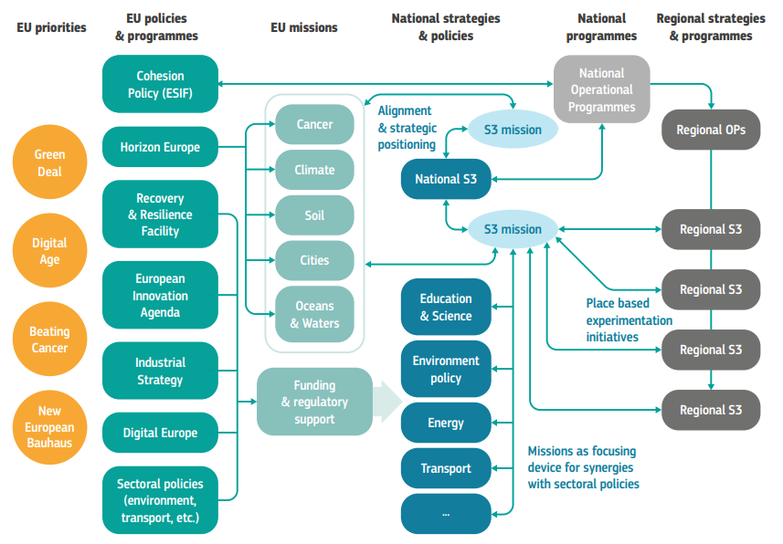
Source: Reid A., Steward F., Miedzinski M., (2023) Aligning smart specialisation with transformative innovation policy.
Lessons for implementing challenge-led missions in smart specialisation, Publications Office of the European Union.

Slide 57
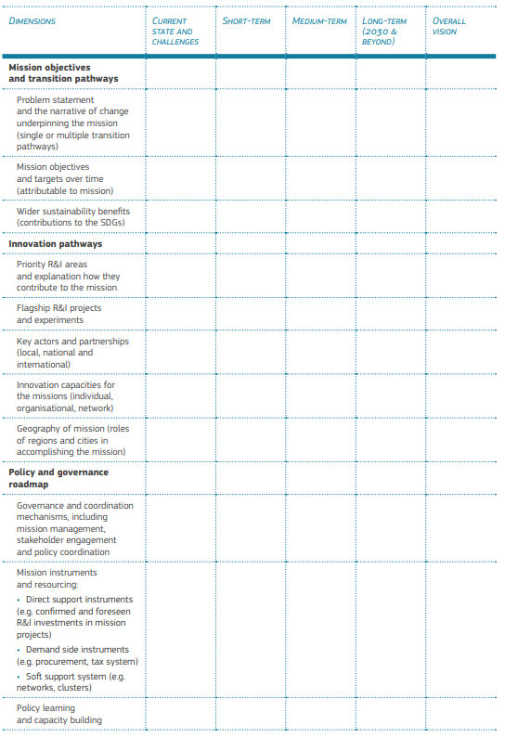
Mission-oriented
roadmap framework
for S3
Source: Reid et al (2023)

Slide 58
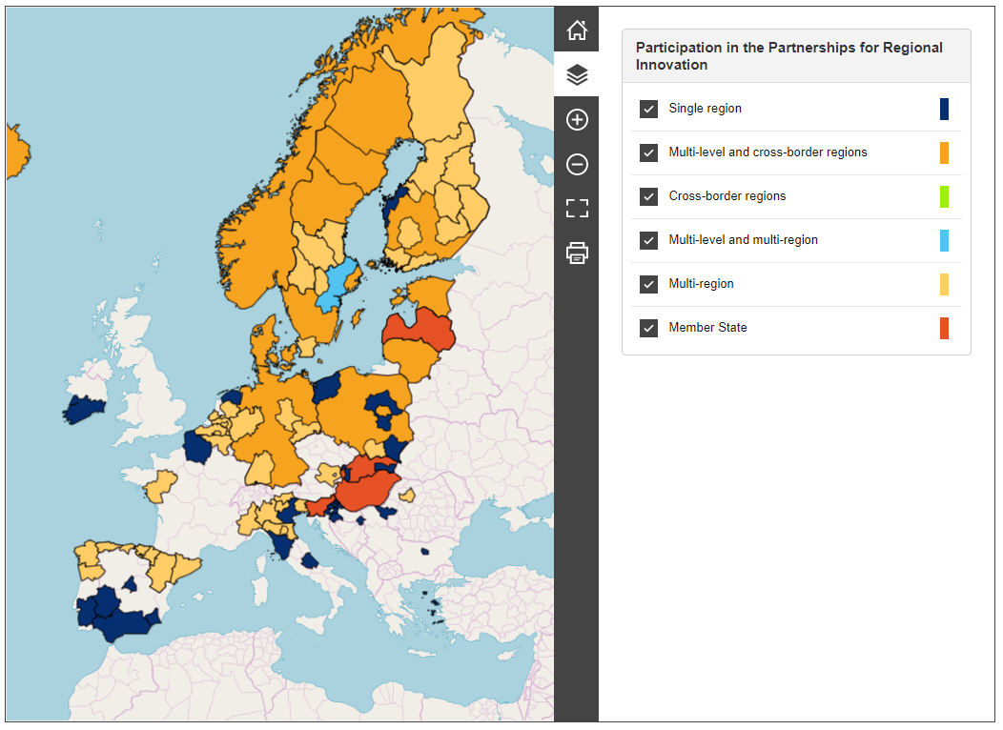
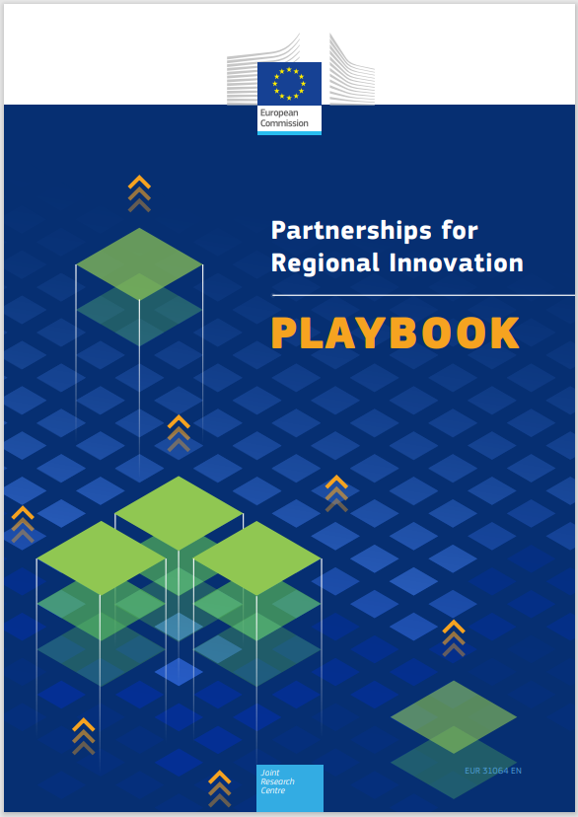
Partnerships for Regional Innovation
An approach to innovation-driven territorial transformation, linking EU priorities with
national plans and place-based opportunities
and challenges.
PRI Playbook and ACTIONbook
Initial support document for a pilot engaging Member States, regions and groups of regions who have volunteered to co-develop the approach, centred on a selection of practical policy tools.
Pilot action
74 territories: 4 Member States, 63 regions (28 single applications, 35 networks), 7 cities, 6 networks of regions
Carried out by the JRC and the Committee of the Regions
https://s3platform.jrc.ec.europa.eu/pri-map
Notes:
Say duration

Slide 59
Closing remarks

Slide 60
Towards transformative regional innovation strategies?
Directionality and system change: Smart specialisation needs to embrace sustainability challenges and consider a wide variety of innovation pathways to accelerate sustainability transition. Transformative S3 need to focuses on how R&I system can be mobilised and strengthened to contribute to sustainability goals.
Real-life experimentation: S3 can become a “policy space” to co-create, experiment and scale innovation responding to local and global sustainability challenges.
Comprehensive policy mix: S3 policy mix needs to balance the support for portfolios of challenge-oriented R&I projects with a patient systemic support to strengthening capacities in regional innovation systems.
Multi-level governance: S3 governance mechanisms need to create synergies between policies at different governance levels and orchestrate alignment between bottom up and top down policy mechanisms.
Policy learning: S3 needs to invest in formative approaches nurturing policy reflection and policy learning between policy makers and relevant stakeholders.

Slide 61
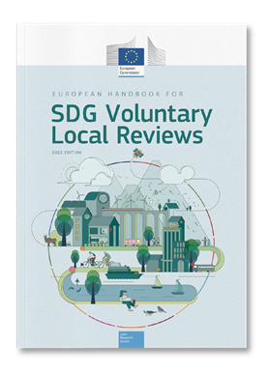
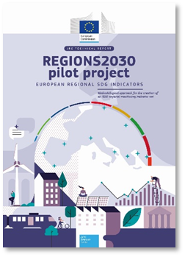
Selected JRC publications

Slide 62

Thank you
© European Union 2020
Unless otherwise noted the reuse of this presentation is authorised under the CC BY 4.0 license. For any use or reproduction of elements that are not owned by the EU, permission may need to be sought directly from the respective right holders.
Notes:
Update/add/delete parts of the copy right notice where appropriate.
More information: https://myintracomm.ec.europa.eu/corp/intellectual-property/Documents/2019_Reuse-guidelines%28CC-BY%29.pdf

Slide 63

ICE BREAKER
WHAT IS OUR MISSION?
WHY AND HOW?
WHEN AND WHERE?
WHO WE ARE?
Notes:
10:35 a 11:15

Slide 64
WORKING SESSION 1
First part
Notes:
11:15 a 13:10

Slide 65

Multilevel perspective framework (MLP)
Global trends / landscape (aging of the population, climate change, digitalization, geopolitical tensions) generate pressure on the current dominant systems, destabilising them and opening windows of opportunity for alternative practices
Interactions between landscape, regimes, and niches are the main driver of systemic transformation
New regime
(new business as usual)
  Policies and governance
  Policies and governance
Current dominant regime: "business as usual" (policies, technologies, markets, social values, infrastructures) adapts slowly to global changes becoming dysfunctional and not delivering the expected results
  Investment and financing
  Society and culture
  Investment and financing
  Society and culture
  Markets
  Science, Technology and infrastructures
  Science, technologies and infrastructures
  Markets
Governments, through S3, can accelerate systemic transitions by nourishing and aligning niches and supporting the expansion and adoption of alternatives aligned with the shared vision of the future
EU and MED innovation and cooperation projects can accelerate the development and adoption of more sustainable alternatives
Emerging alternative practices (niches) with the potential to lead to the “new business as usual”
Time
Source: Adapted from TIPC, based on Geels and Schot (2007)

Slide 66

Understanding the complexity of the problem of depopulation in remote and rural areas
50 minutes (11.15 – 12.05)

Slide 67

Supporting mass production
Prioritising exports and GDP growth
Environmental costs are integrated into GDP
65 minutes:
12:25 – 13:10
14:30 – 14:50
30 minutes:
14:50 – 15:20
People care for the well-being of farm animals

Slide 68
  Envisioning transition pathways
  WE ARE IN 2070 and we have strong, connected, resilient and prosperous rural and remote areas
    What was the pathway that made it possible?
        What did we let go from the past (2024) and how did we support it?
        What has emerged and how did we support it?
    Describe the pathway that made it possible from 2024 to 2070 considering the different dimensions and the necessary changes in mindsets and behaviours at individual and organisation levels.
60 minutes:
15:20 – 16:20

Slide 69
ICE BREAKER
WHAT IS OUR MISSION?
WHY AND HOW?
WHEN AND WHERE?
WHO WE ARE?
Notes:
10:35 a 11:15

Slide 70
WORKING SESSION 1
First part
Notes:
11:15 a 13:10

Slide 71
Multilevel perspective framework (MLP)
Global trends / landscape (aging of the population, climate change, digitalization, geopolitical tensions) generate pressure on the current dominant systems, destabilising them and opening windows of opportunity for alternative practices
Interactions between landscape, regimes, and niches are the main driver of systemic transformation
New regime
(new business as usual)
  Policies and governance
  Policies and governance
Current dominant regime: "business as usual" (policies, technologies, markets, social values, infrastructures) adapts slowly to global changes becoming dysfunctional and not delivering the expected results
  Investment and financing
  Society and culture
  Investment and financing
  Society and culture
  Markets
  Science, Technology and infrastructures
  Science, technologies and infrastructures
  Markets
Governments, through S3, can accelerate systemic transitions by nourishing and aligning niches and supporting the expansion and adoption of alternatives aligned with the shared vision of the future
EU and MED innovation and cooperation projects can accelerate the development and adoption of more sustainable alternatives
Emerging alternative practices (niches) with the potential to lead to the “new business as usual”
Time
Source: Adapted from TIPC, based on Geels and Schot (2007)

Slide 72
Understanding the complexity of the problem of depopulation in remote and rural areas
50 minutes (11.15 – 12.05)

Slide 73
Supporting mass production
Prioritising exports and GDP growth
Environmental costs are integrated into GDP
65 minutes:
12:25 – 13:10
14:30 – 14:50
30 minutes:
14:50 – 15:20
People care for the well-being of farm animals

Slide 74
  Envisioning transition pathways
  WE ARE IN 2070 and we have strong, connected, resilient and prosperous rural and remote areas
    What was the pathway that made it possible?
        What did we let go from the past (2024) and how did we support it?
        What has emerged and how did we support it?
    Describe the pathway that made it possible from 2024 to 2070 considering the different dimensions and the necessary changes in mindsets and behaviours at individual and organisation levels.
60 minutes:
15:20 – 16:20

Slide 75
LUNCH BREAK
Notes:
13:10 a 14:30

Slide 76
WORKING SESSION 1
Second part
Notes:
14:30 a 16:20

Slide 77
PLENARY SESSION
Notes:
16:20 a 17:00

Slide 78
Welcome to the Innovative Sustainable Economy Mission
2nd Innovation Camp
BARCELONA 28-29 May 2024

Slide 79
Moving into action: connecting MED projects, S3 and the MED Innovative Sustainable Economy Mission (MISE)
Alasdair Reid,
EFIS Centre
Elisabetta Marinelli,
S3 CoP
Alessandro Daraio,
Dialogue4Innovation
Fernando Mérida,
Spanish Government
Session moderated by Cynthia Echave
Notes:
9:30 a 10:30

Slide 80
WORKING SESSION 2
First part
Notes:
10:30 a 11:45

Slide 81
Transformative innovation for a more sustainable economy in the MED: conceptual framework, capacity building and tools proposed by the Dialogue4Innovation Project

Slide 82
TODAY

Slide 83

How can we create spaces for place-based and challenge-led action for an Innovative Sustainable Economy in the MED?
  SPACES FOR:
  UNDERSTANDING THE PLACE-BASED CHALLENGE
    Stakeholders develop a shared systemic and MLP understanding of the problem they want to address
    Stakeholders define a shared vision of the future they want to work for and explore possible pathways
  ACTION: Stakeholders collaborate in experimental spaces to explore, develop, test and demonstrate alternatives aligned with the shared vision of the future
  LEARNING AND DIFFUSION OF ALTERNATIVES: generation of new knowledge and evidences facilitating the adoption of alternatives aligned with shared the vision of the future
  ADOPTION OF ALTERNATIVES: A NEW BUSINESS AS USUAL

Slide 84
Dialogue4Innovation proposal
Conceptual frameworks and guidelines to address MED sustainability challenges more effectively through Transformative Innovation Policy
Capacity building and tools for S3 policy makers and Interreg Euro MED thematic projects (MOOCs, Innovation Camps)
Co-design and deployment of a MED network of Transformative Innovation Policy Labs (TIPL): meeting spaces to align local, regional, national and MED priorities and stakeholders’ efforts for a more Sustainable Innovative Economy within the MED

Slide 85
The roadmap to design and implement TIPL
2024-2028: Innovation Camps, guides, methodological tools MOOCs
2025-2026: Design and deployment of the first generation of TIPL:
  Led by D4I Partners in their regions or directly or (in the case of CPMR, AIE, OSC, ARC-Medwaves) through public authorities or groups of stakeholders engaged with a policy action falling under the Mission scope willing to implement the proposed approach.
  The first-generation TIPLs will foster a learning by doing process
  Development and implementation of a monitoring-evaluation-learning (MEL) framework for monitoring the results of the TIPL: experimenting, testing, learning and co-creating more effective approaches, guidelines and tools to increase the transformative impact of S3 and MED thematic projects
  2027-2028: Deployment of the second generation of TIPL
  Training for “MISE Ambassadors”, selected in a transparent and inclusive way across the Mediterranean to replicate TIPL in other MED territories
  The “hosting” institutions of TIPL will be selected through an open call from the MISE hub and will be supported by a dedicated technical assistance package.

Slide 86
How do we envision TIPLs?

Slide 87
  Today
  Exploring the opportunities to amplify the impact of Interreg Euro MED innovation projects and MED S3
  How can the Dialogue4Innovation Project support this process?
  Co-designing the Transformative Innovation Policy Labs
Today’s agenda

Slide 88
BREAK
Notes:
11:45 a 12:15

Slide 89
WORKING SESSION 2
Second part
Notes:
12:30 a 13:30

Slide 90
LUNCH BREAK
Notes:
13:30 a 15:00

Slide 91
WRAP UP SESSION
Notes:
15:00 a 16:30

